Slide 1
DegreeWorks 5
(Students)
Last updated: Sep 2023

Slide 2
Contents
Access to DegreeWorks
Features of DegreeWorks
Degree Audit Report
Student View
Registration Checklist
Class History
Request for reviewing and updating audit report
Features of DegreeWorks
What If
Look Ahead
Student Educational Planner (SEP)

Slide 3
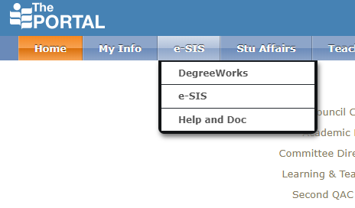
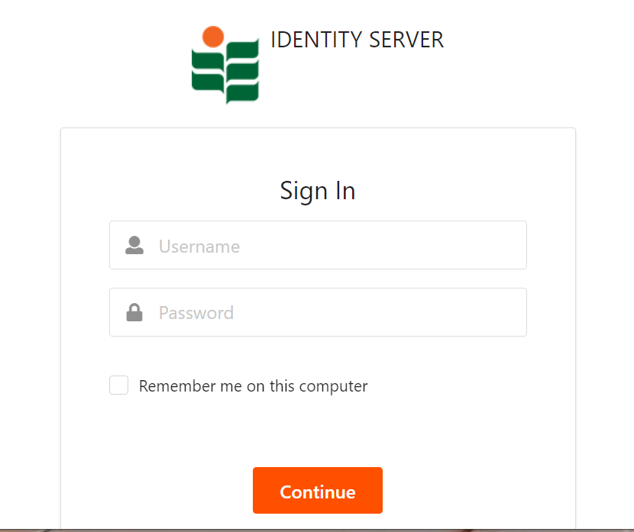
Access to DegreeWorks
https://dw.eduhk.hk/dwDashboard/

Slide 4
https://eduhk.ap.panopto.com/Panopto/Pages/Embed.aspx?id=af6de817-abce-459d-8902-b06100887d4e&autoplay=false&offerviewer=true&showtitle=true&showbrand=true&captions=false&interactivity=all

Slide 5
Features of DegreeWorks Degree Audit Reports
Student View (default)
Student View allows advisors and students to identify which graduation requirements have been satisfied or still outstanding.
The requirements are displayed in blocks.

Slide 6
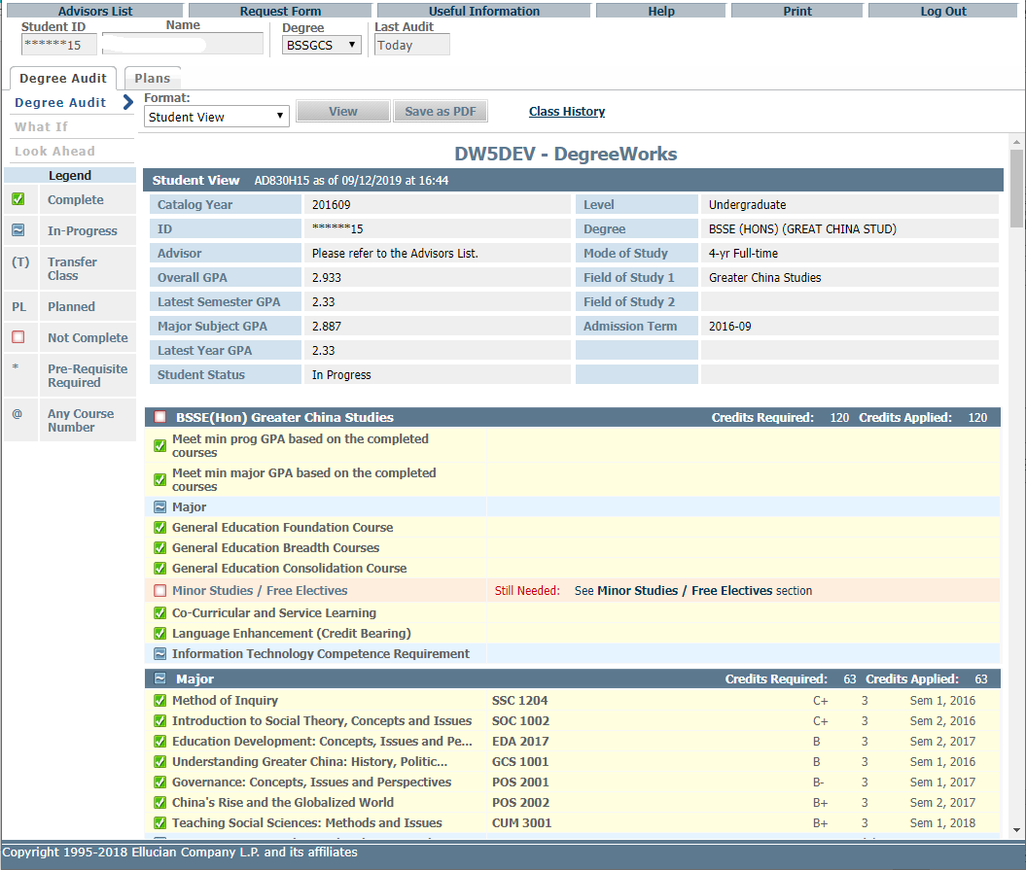
Functional buttons
Student View (default)
Student Information
Blocks

Slide 7
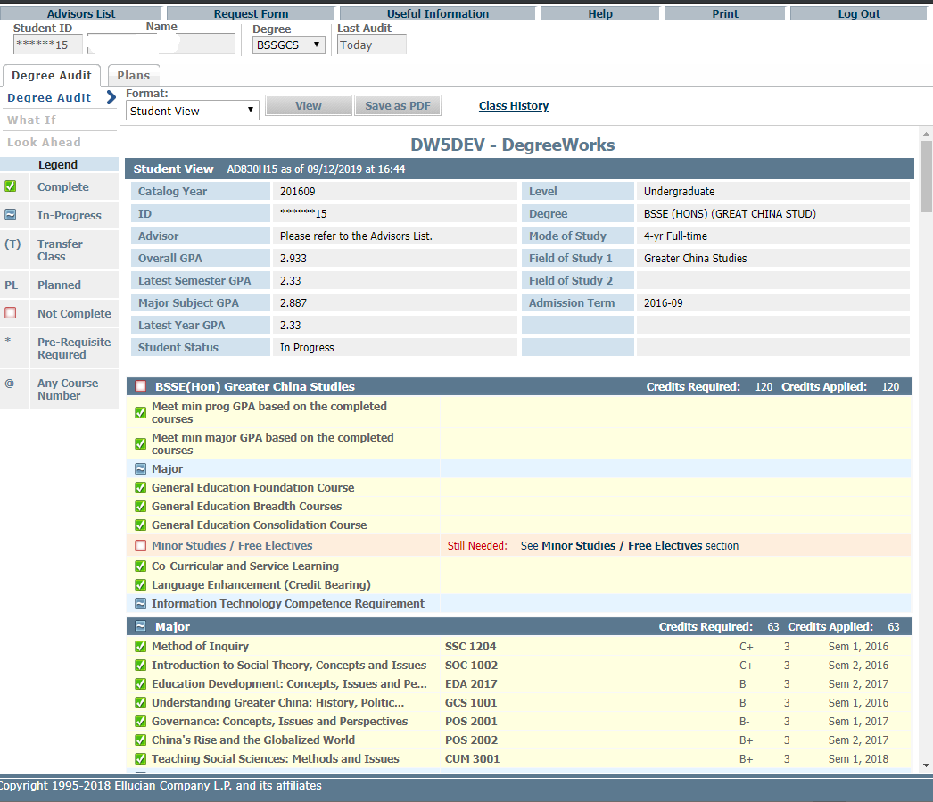
Program Requirement
Block/Domain fulfilment
Complete
In-Progress
Not complete
Study Block

Slide 8
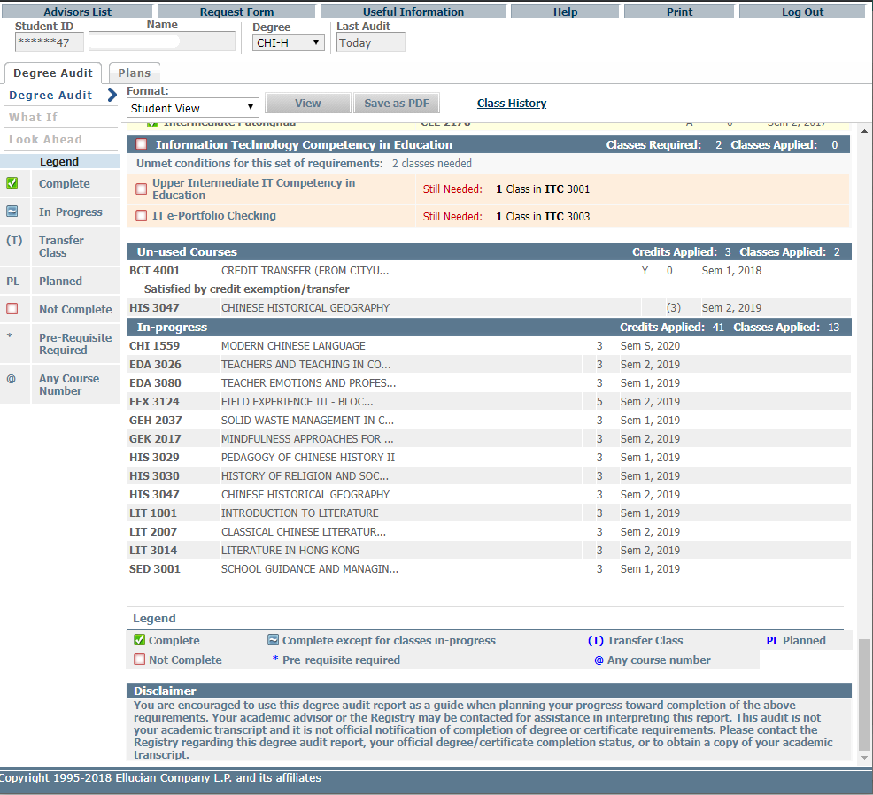
May still count towards your graduation requirements

Slide 9
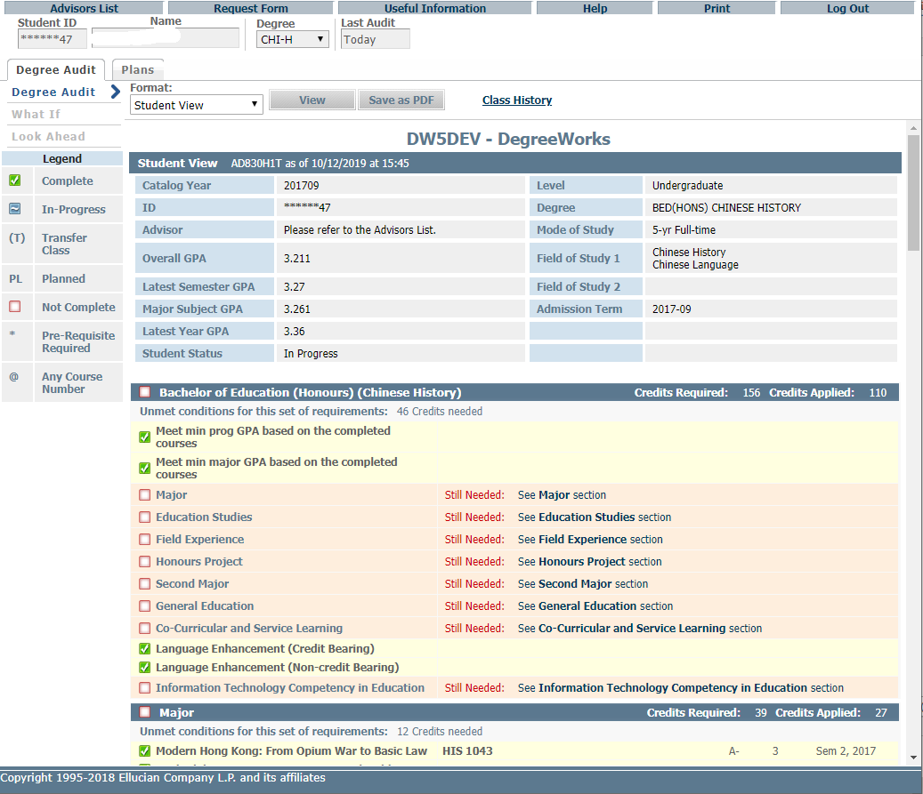
Features of DegreeWorks Degree Audit Reports
Save and download DAR for advising meeting

Slide 10
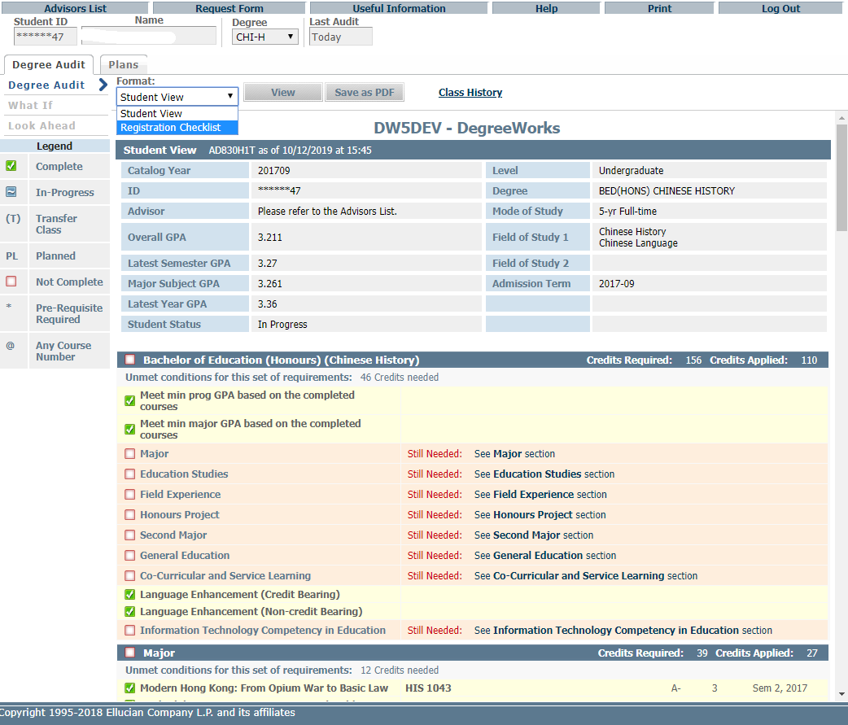
Features of DegreeWorks Degree Audit Reports (DAR)
Registration Checklist
Shows only the "Still Needed" courses.
Choose from the pull down menu
and press ‘View’

Slide 11
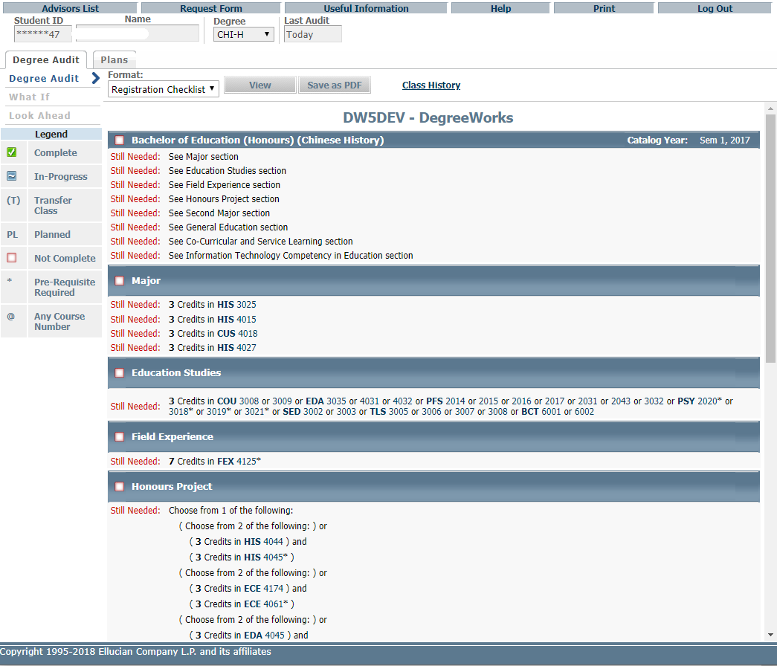
Courses still needed

Slide 12
Features of DegreeWorks Degree Audit Reports
Class History
List of completed courses with grades and credits grouped by semester.

Slide 13
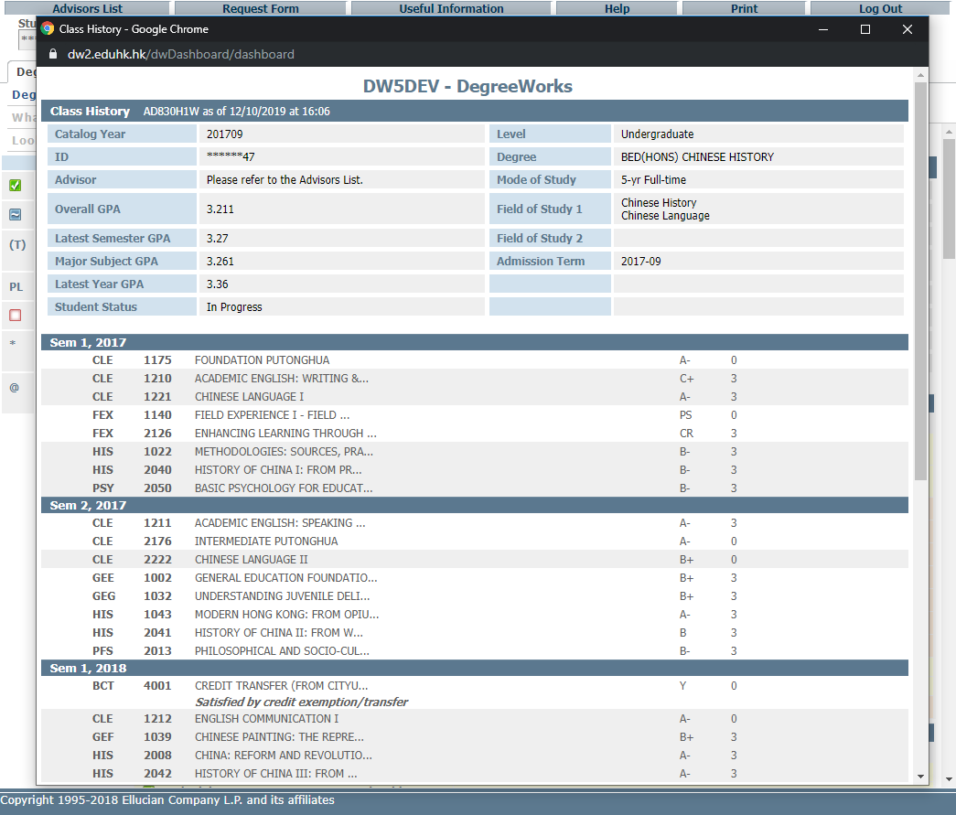
Listing of completed courses with grades and credits shown in chronological order

Slide 14
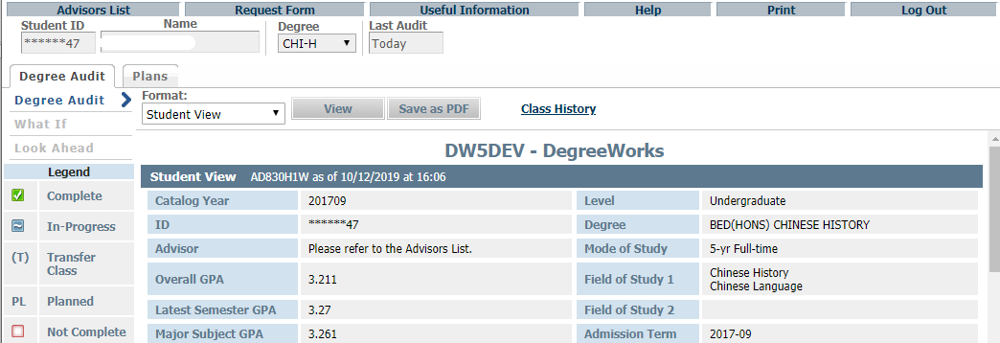
Request for reviewing and updating audit report
Fill in the issues found in the Degree Audit Report on this request form and report to Registry via email to exam@eduhk.hk

Slide 15
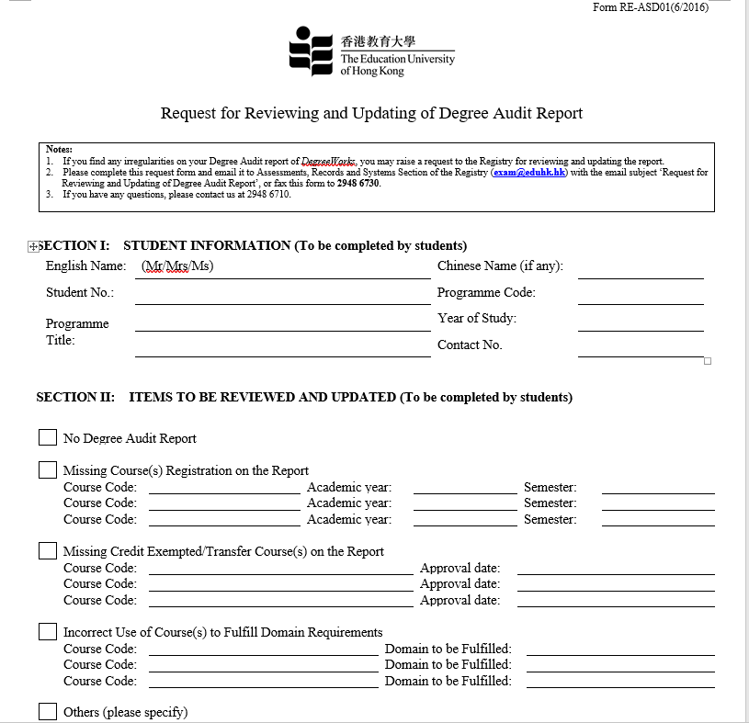
Complete the form and send email to Registry exam@eduhk.hk

Slide 16
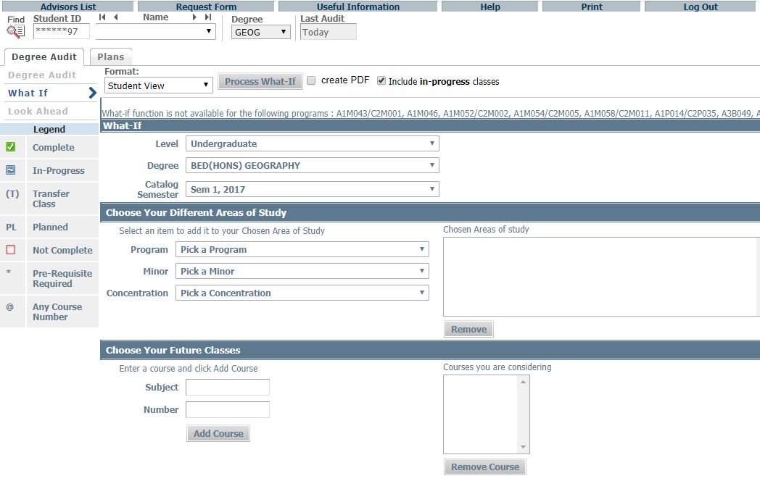
Features of DegreeWorks What If
The “What-if” function shows the study progress towards program completion or to plan a Second Major/Minor or even ‘Change of Programme’. Students can also include those unregistered classes to be taken in the coming semester(s).

Slide 17
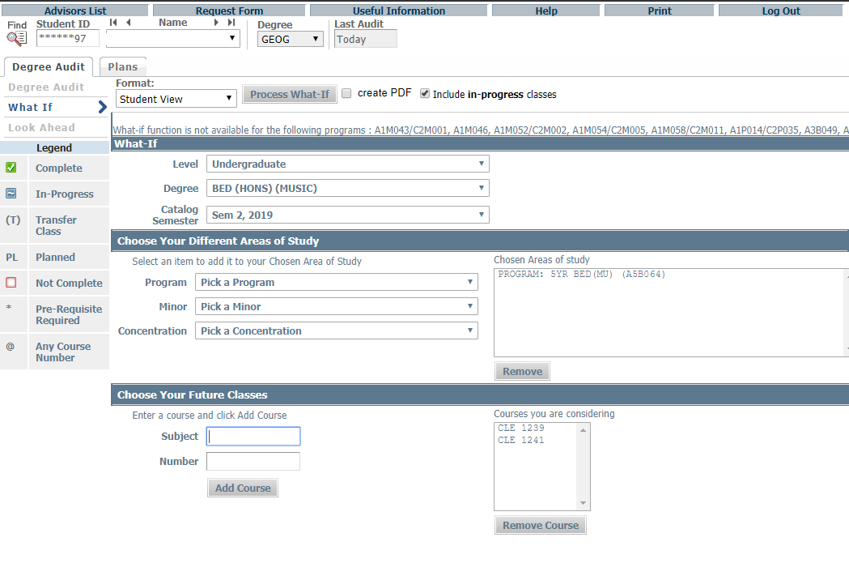
Click here to Process
Choose program/ Concentration (Major) to check on the curriculum and course requirement
Chosen Courses will shown in here
Enter course code directly in here and press ‘Add’

Slide 18
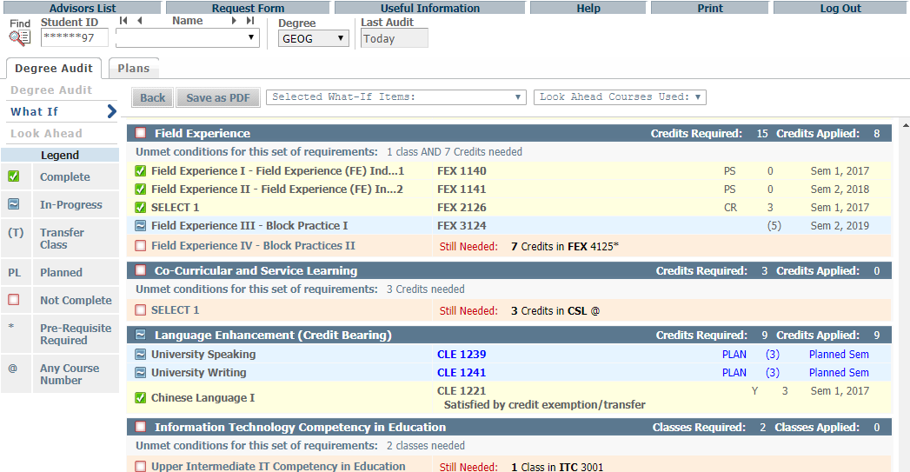
What-If Audits will not store in the database. After process run, the results can only be printed out by using the Save as PDF button. Navigating away from ‘What-If’ page, the audit cannot be recalled again.
Click “Save as PDF” before leaving the page, otherwise the plan will be lost
Planned courses will be shown in BLUE under the chosen semester

Slide 19
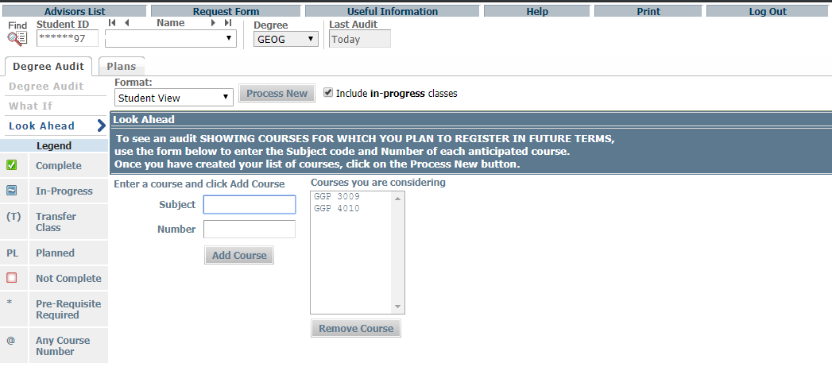
Features of DegreeWorks Look Ahead
The Look Ahead allows the audit to include unregistered courses which the student plans to take in the future.
Click here to Process
Chosen courses will be shown here
Enter course code directly in here and press ‘Add’
You can remove chosen course here

Slide 20
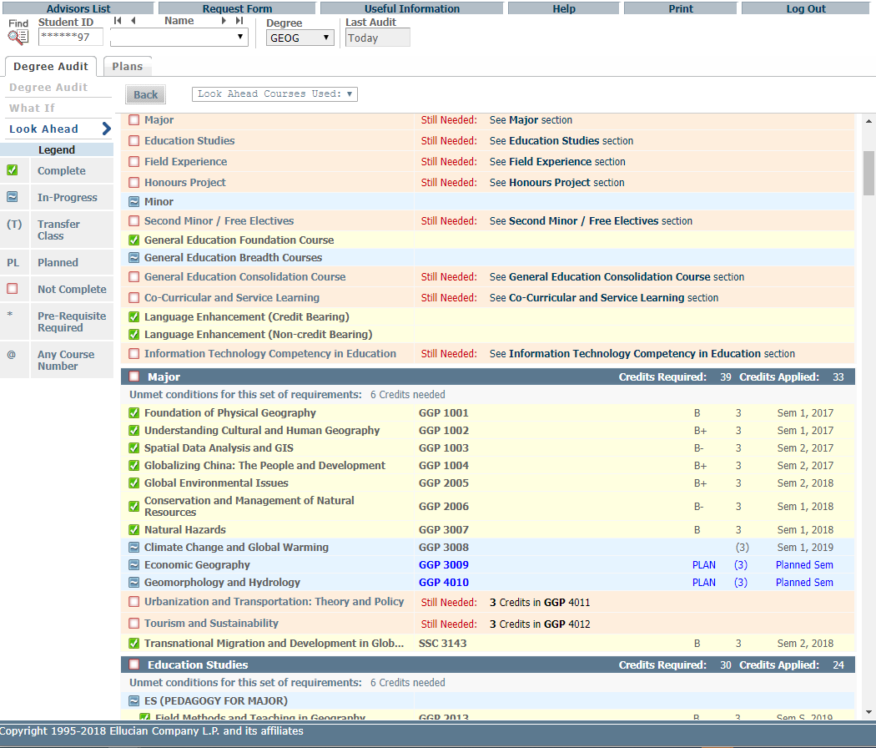
Planned courses will be shown in BLUE under the chosen semester

Slide 21
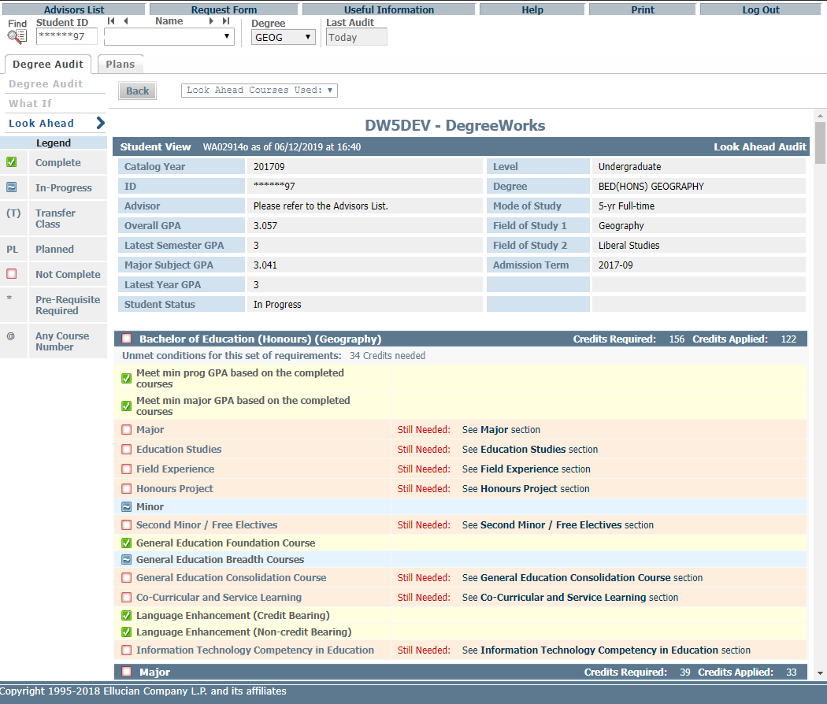
Look Ahead Audits will not store in the database. After process run, the results can only be saved through printing out for record. Navigating away from the ‘Look Ahead’ page the audit cannot be recalled again.

Slide 22
Features of DegreeWorks Student Educational Planner (SEP)
Why is having a study plan important?
A learning tool: Through working on their study plan, students can understand the overall requirements of the programs and how to meet the graduation requirements.
A self-evaluation tool: In creating a plan, students can estimate how many courses they want to take each semester and judge whether they can balance the class load with other obligations in their studies.
A road map to academic success: Students with an academic plan have a clear direction and understanding of how to complete their programs.

Slide 23
Click ‘Plans’ to access the Student Educational Planner (SEP)
under Student View
Edit View
Edit View is the default view to show all your saved study plans
Click “View Plan List” if more than one plan is saved

Slide 24
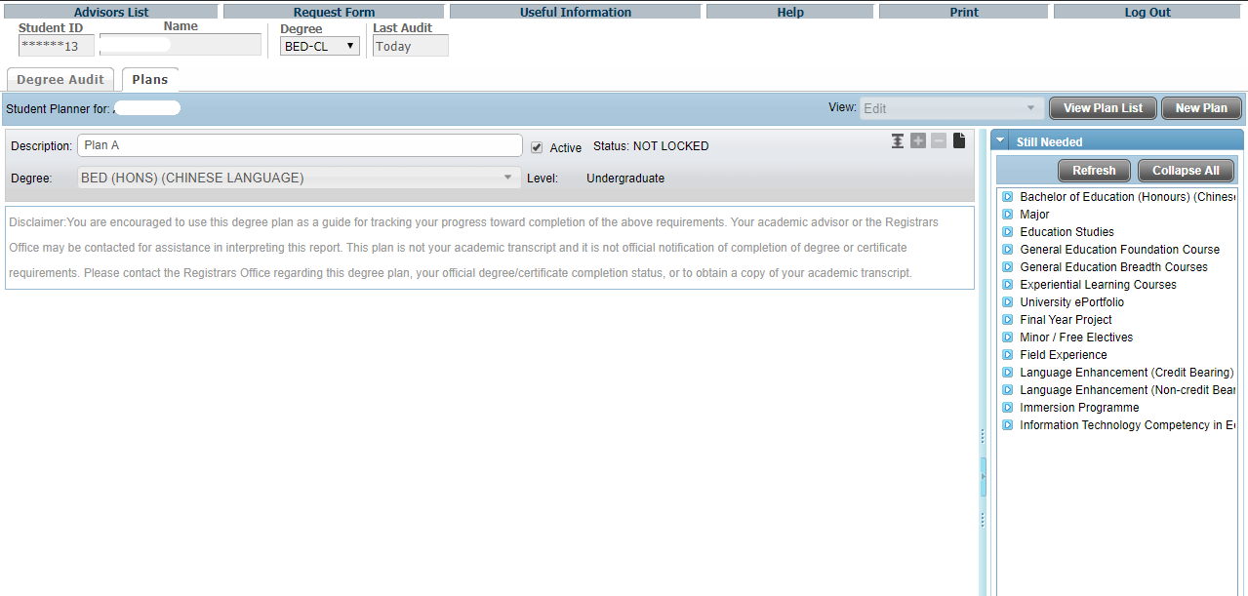
Students can save their study plan as ‘Active’ to submit for advising meetings.
To create a plan, you are required to type the name, e.g. Plan A, in the description.
Each student can have numerous plans but ONLY ONE Active Plan, click here to make your plan ‘Active’. Old/outdated plans should not be marked active.
Click ‘New Plan’ to make a plan after viewing your saved one(s)

Slide 25
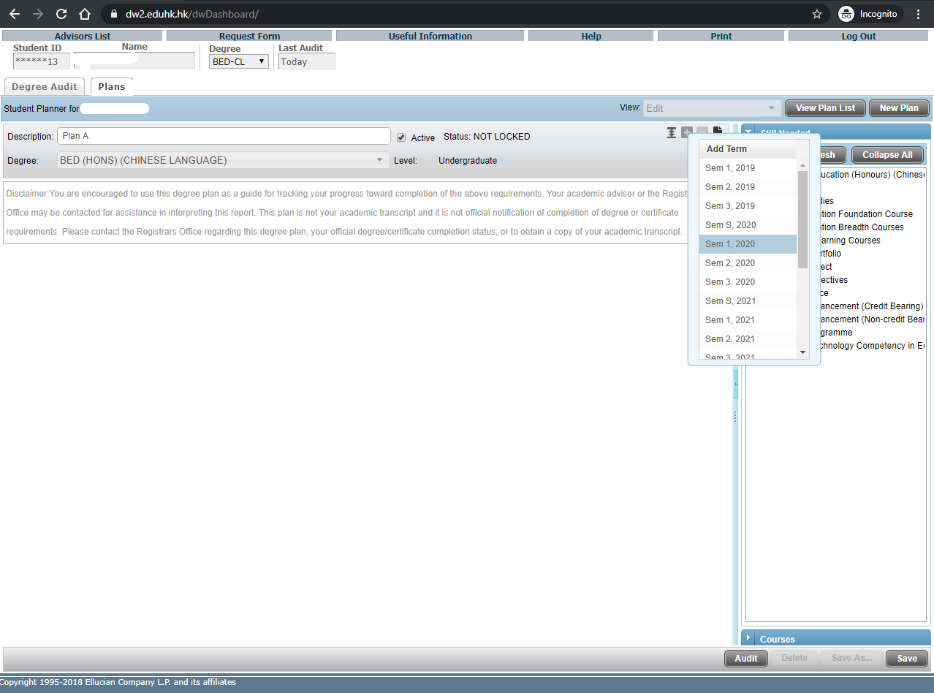
Click here to add or delete the semester for your SEP
Pick the semester for insert/delete

Slide 26
The ‘Still Needed’ view provides course information from the student audit
The inventory list is expandable, and the drag-and-drop function for course selection can facilitate students to create plans.
The “Courses” view provides a Catalog inventory listing

Slide 27
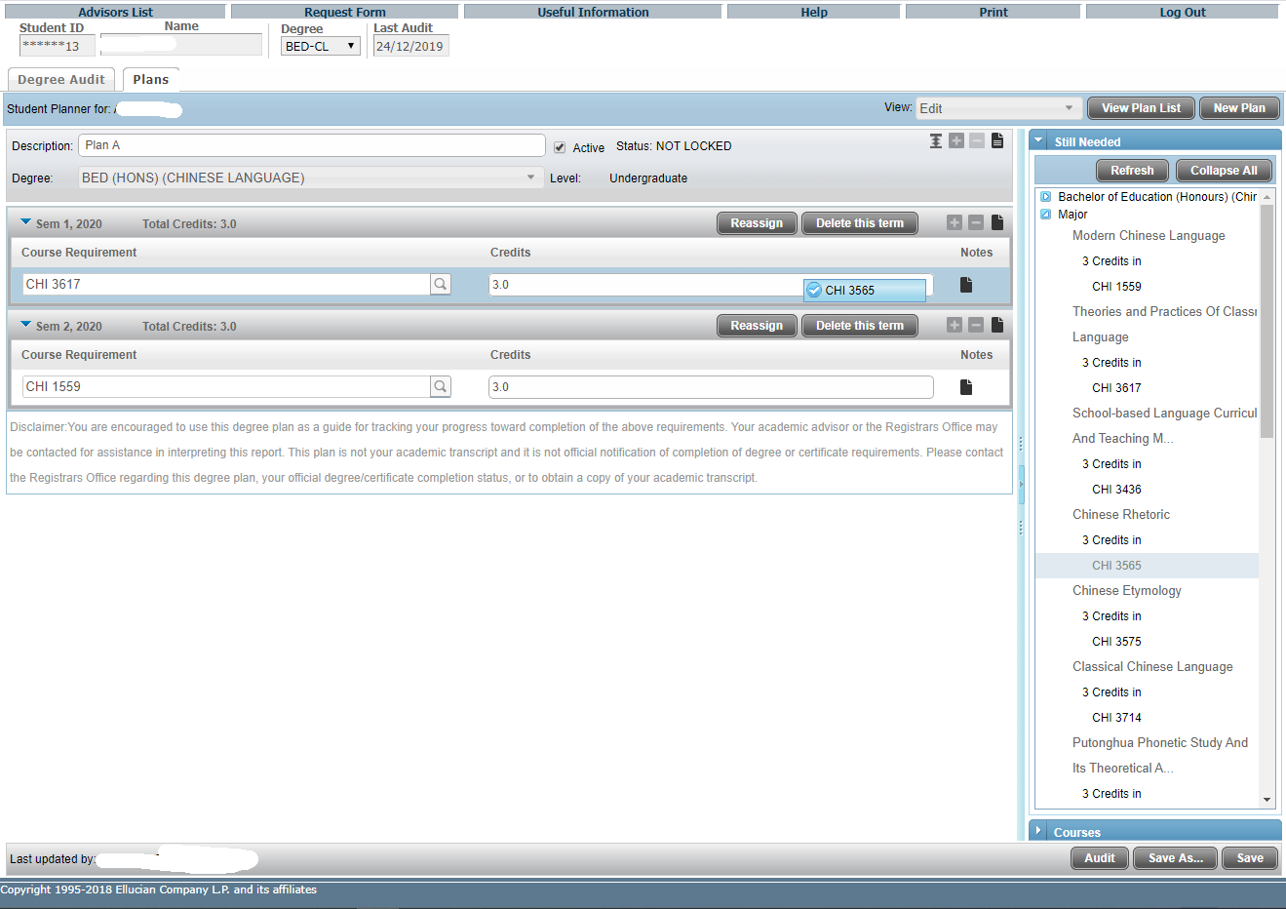
You can enter the course code directly by clicking here
Courses under ‘Still Needed’ or ‘Courses’ panel can be Drag-and-Drop into the designated semester

Slide 28
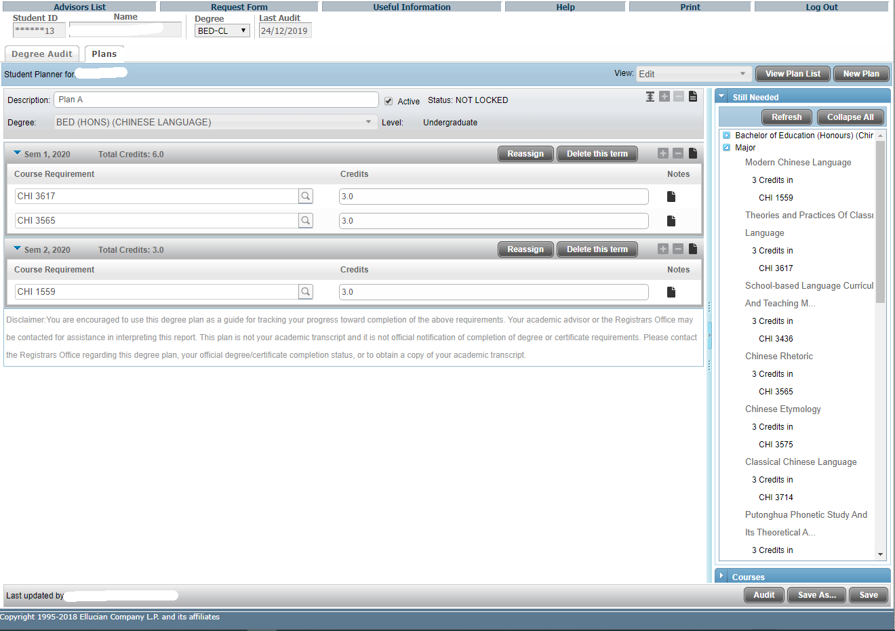
Once inserted, the selected courses will be shown in the designated semester.
You can reassign all selected courses to another semester;
or
Delete the whole semester.

Slide 29
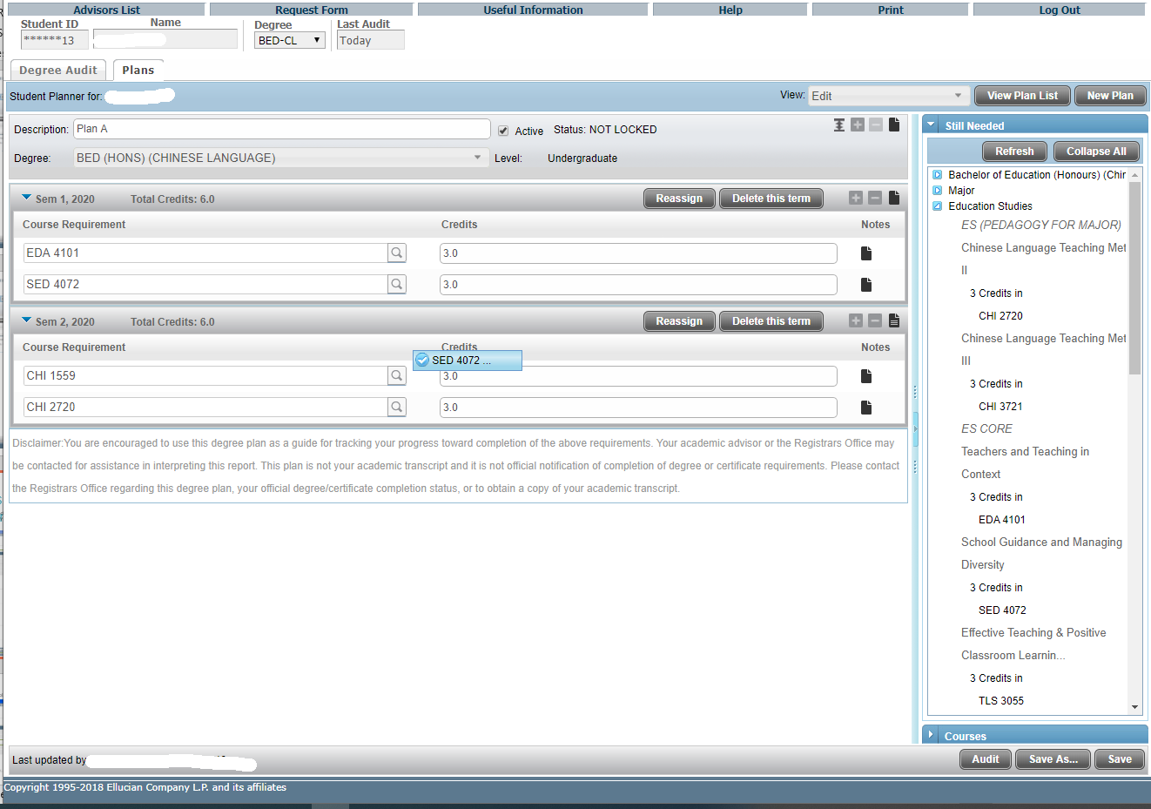
Individual courses can be Drag-and-Drop between semesters.
Drag the course from Sem 1, 2020 to Sem 2, 2020
Press ‘Save’ for an existing plan or ‘Save As’ for a different plan

Slide 30
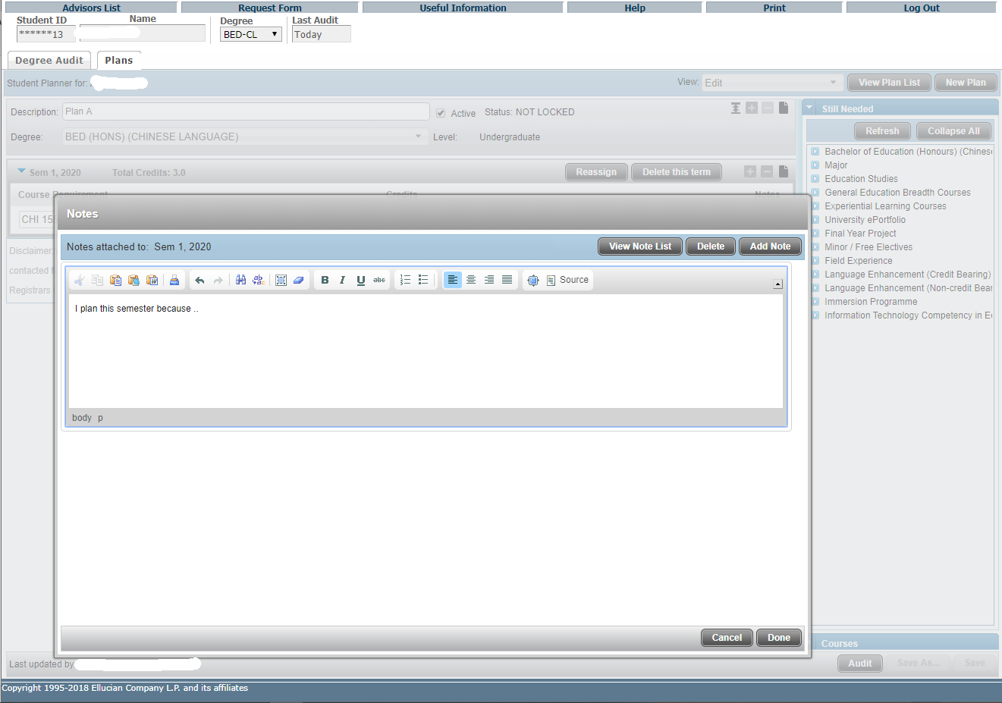
Click here to enter the Plan-level note
(in ENGLISH only)
or leave messages to your advisor when reviewing your plan.
Click ‘Done’ to save

Slide 31
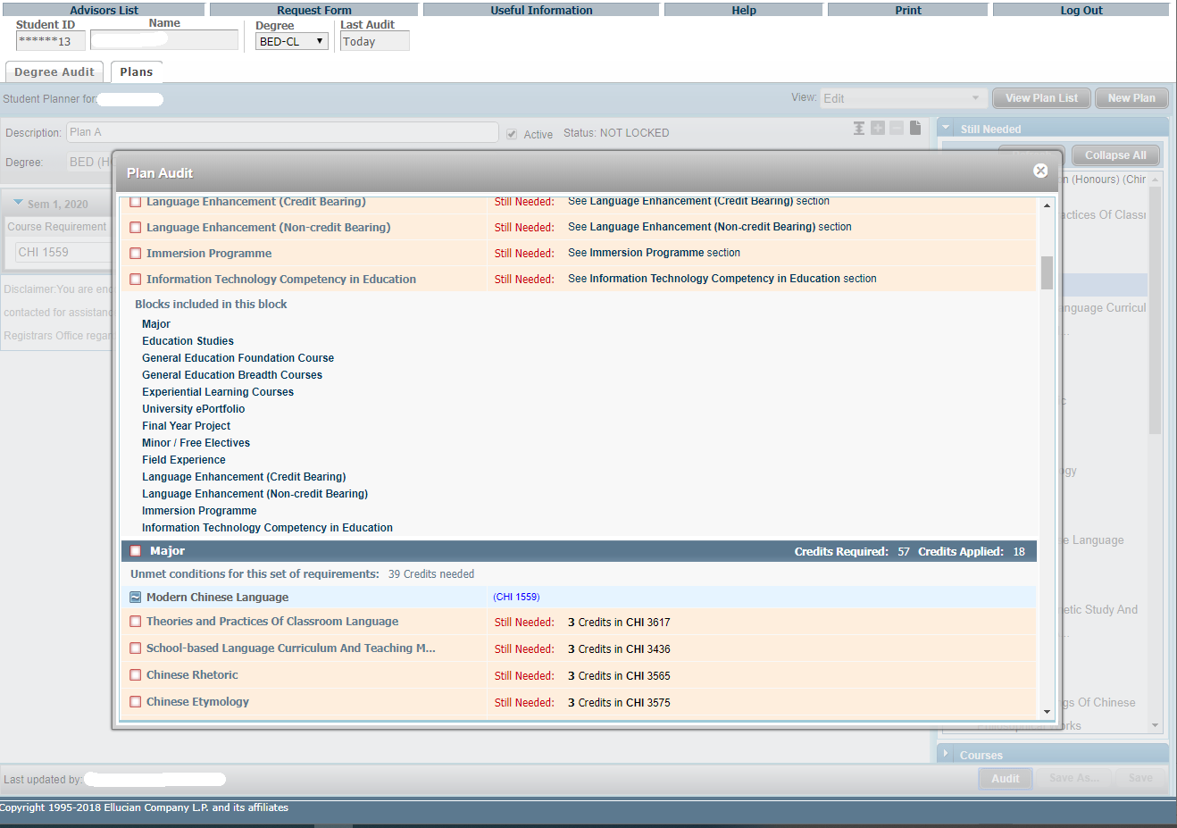
Click ‘Audit’ in Edit View to generate a Plan Audit, which will display all courses from the Plan in an advising worksheet in an embedded window.
The planned requirements are highlighted

Slide 32
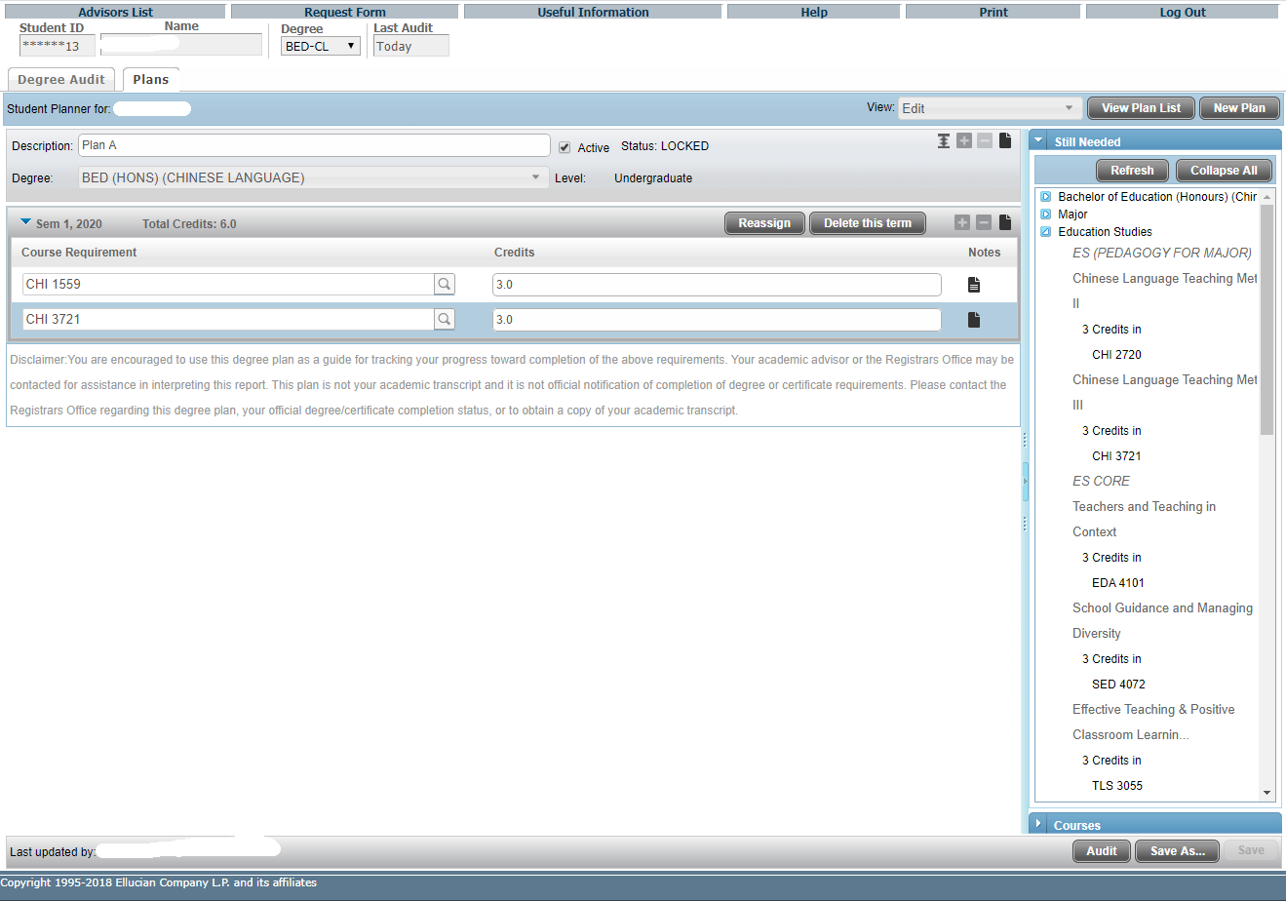
There is a ‘LOCKED’ key for advisors to prevent their advisees from making any changes to a plan that had been reviewed/discussed.
Students cannot make any modification to the ‘LOCKED’ plan but can recall and ‘Save As’ another plan for editing.

Slide 33
View Plan List
Click “View Plan List” to view the full list of your plan(s) including ‘Active’.
View all plans
To delete an un-used plan, click to select the plan.
Click “Delete” and “Yes” to confirm to permanently delete the plan.

Slide 34
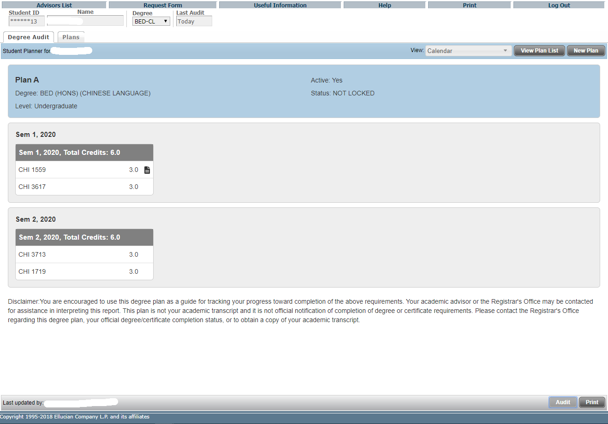
Calendar View
Display study plan in calendar presentation that is suitable for printing.
(No editing is available in this view )

Slide 35
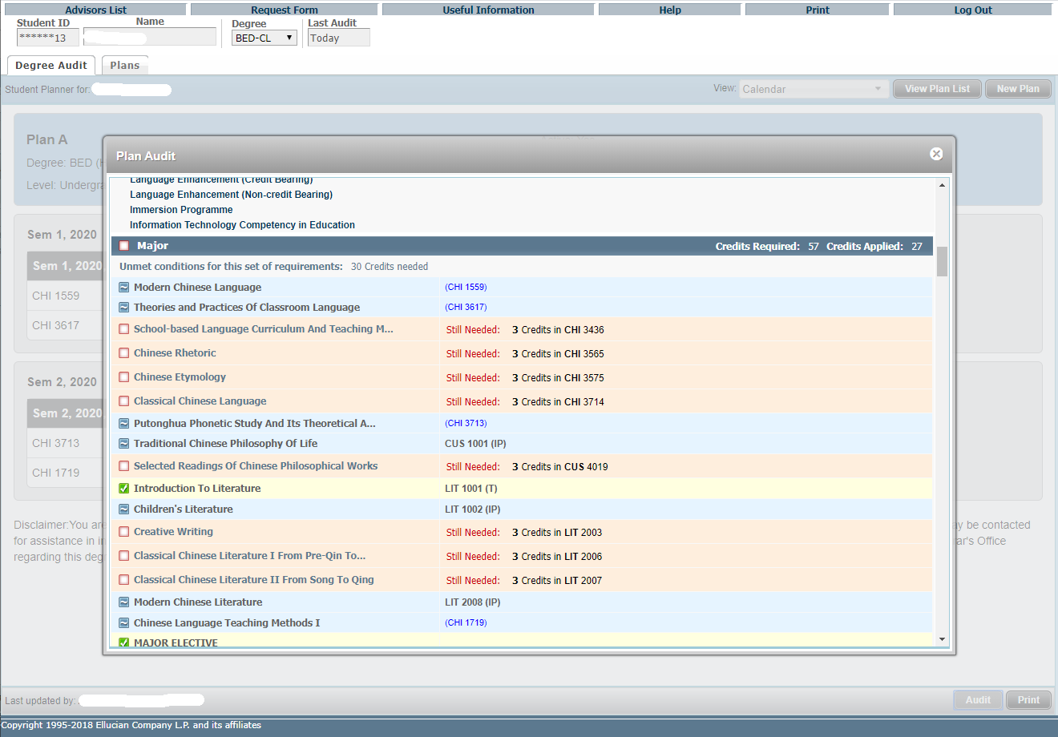
Click ‘Audit’ in Calendar View to generate a Plan Audit, which will display all courses from the Plan in an advising worksheet in an embedded window.
The planned requirements are highlighted

Slide 36
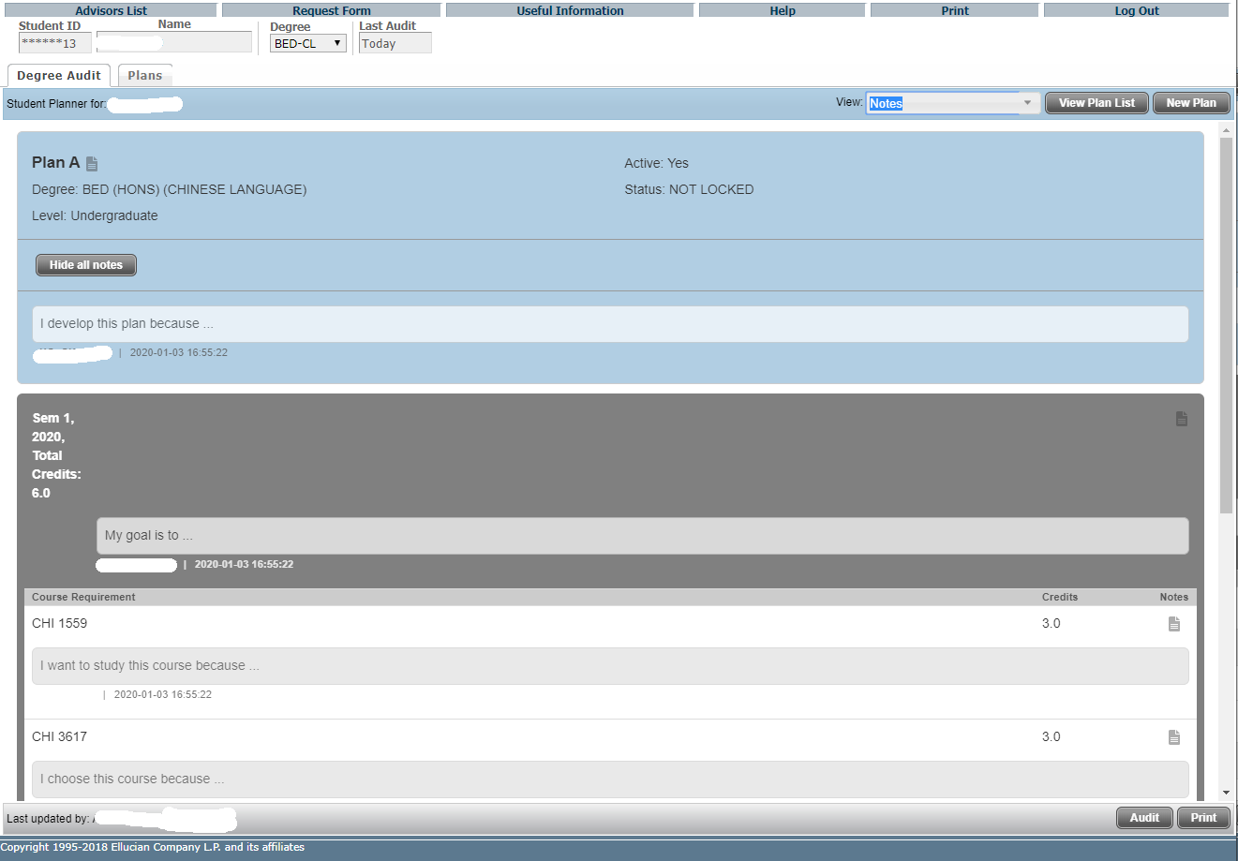
Note View
The Notes view allows the user to view a plan in a comprehensive presentation that is suitable for printing.
(Again, no editing of the plan is available in this view )
Under the Expanded mode, all selected courses, semesters and notes display underneath the corresponding items and will be included when printing. Click “Print” for printing.

Slide 37
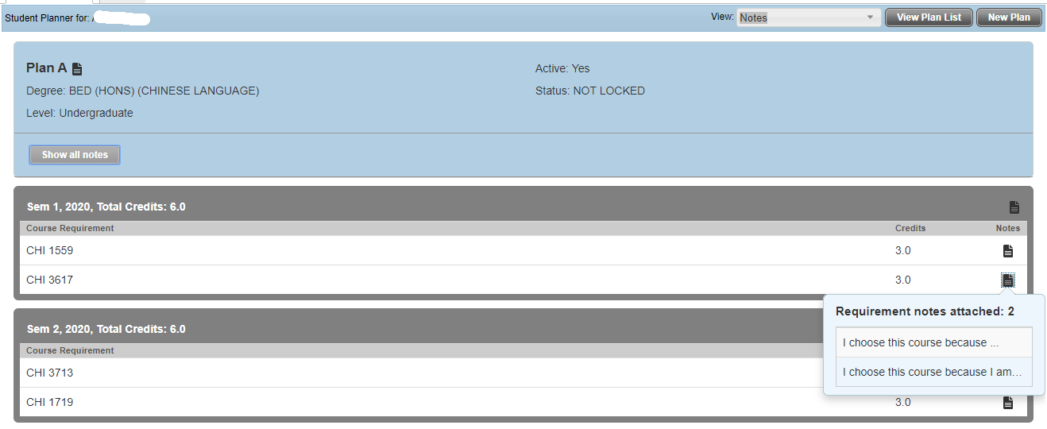
Click “Hide all notes” to enter Collapsed mode
With the Collapsed mode, only a note icon will display with NO content will be included when printing.
Hover to show a note preview, and click on this icon to open the Notes window.

Slide 38
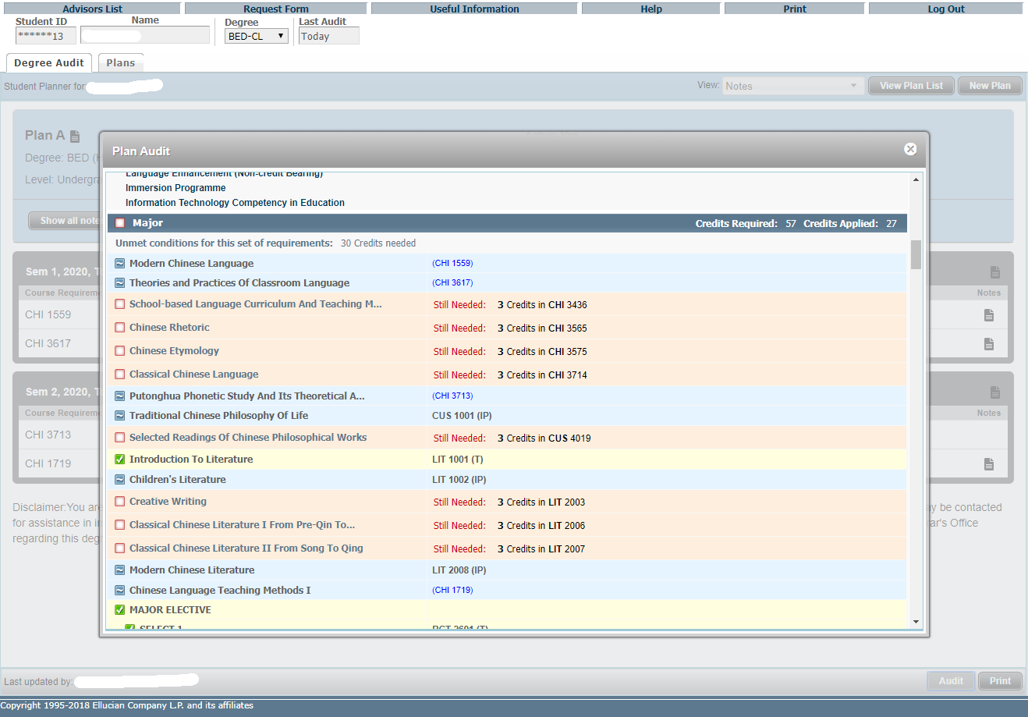
Click ‘Audit’ in Notes View to generate a Plan Audit, which will display all courses from the Plan in an advising worksheet in an embedded window.
The planned requirements are highlighted

