Slide 1
DegreeWorks 5
(Students)
Last updated: Sep 2024

Slide 2
Contents
Overview of DegreeWorks
How DegreeWorks Benefits You
How to use

Slide 3
About DegreeWorks
Access to DegreeWorks
Features of DegreeWorks
Degree Audit Report
Student View
Registration Checklist
Class History
Request for reviewing and updating audit report
Advanced Features of DegreeWorks
What If
Look Ahead
Student Educational Planner (SEP)

Slide 4
What is DegreeWorks
Web-based degree auditing and tracking tool
Open to all students (doctorate to higher diploma), except Professional Development Programmes (PDP)
Easily identify completed and outstanding requirements
"What-if" and "Look-ahead" analysis for major changes
Helps visualize the impact of academic decisions
GPA indicator to keep students on track
Credit transfer tracking for course fulfillment

Slide 5
How DegreeWorks Benefits You
Real-time tracking of degree progress
Easily check fulfillment status for Majors, Minors, Electives, General Education, and Language Enhancement courses
Identify courses with credit transfers and outstanding requirements for graduation
Environmentally friendly: online tool reduces errors
Supports students' academic goals
"What-if" function for exploring different majors and minors
Simplifies Second Major/Minor declaration process
Helps students stay on track and plan for graduation

Slide 6
Briefing Introduction of Feature
Video Source: https://advising.eduhk.hk/about-degreeworks

Slide 7
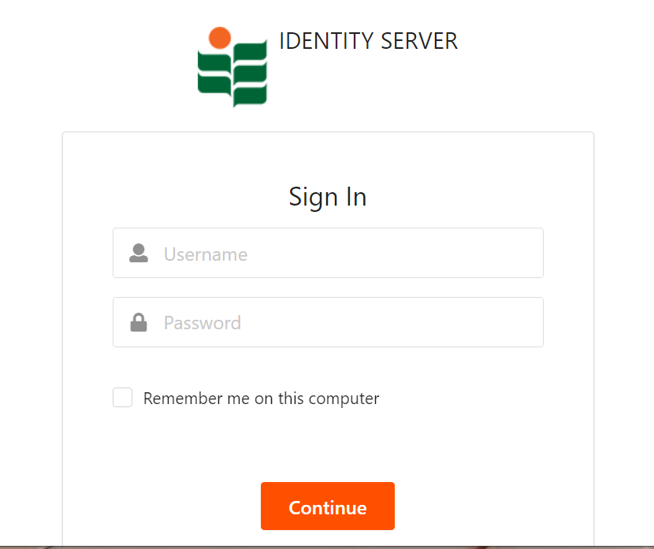
Access to DegreeWorks
https://dw.eduhk.hk/

Slide 8
Features of DegreeWorks
Degree Audit Reports
Student View (default)
Student View allows advisors and students to identify which graduation requirements have been satisfied or still outstanding.
The requirements are displayed in blocks.

Slide 9
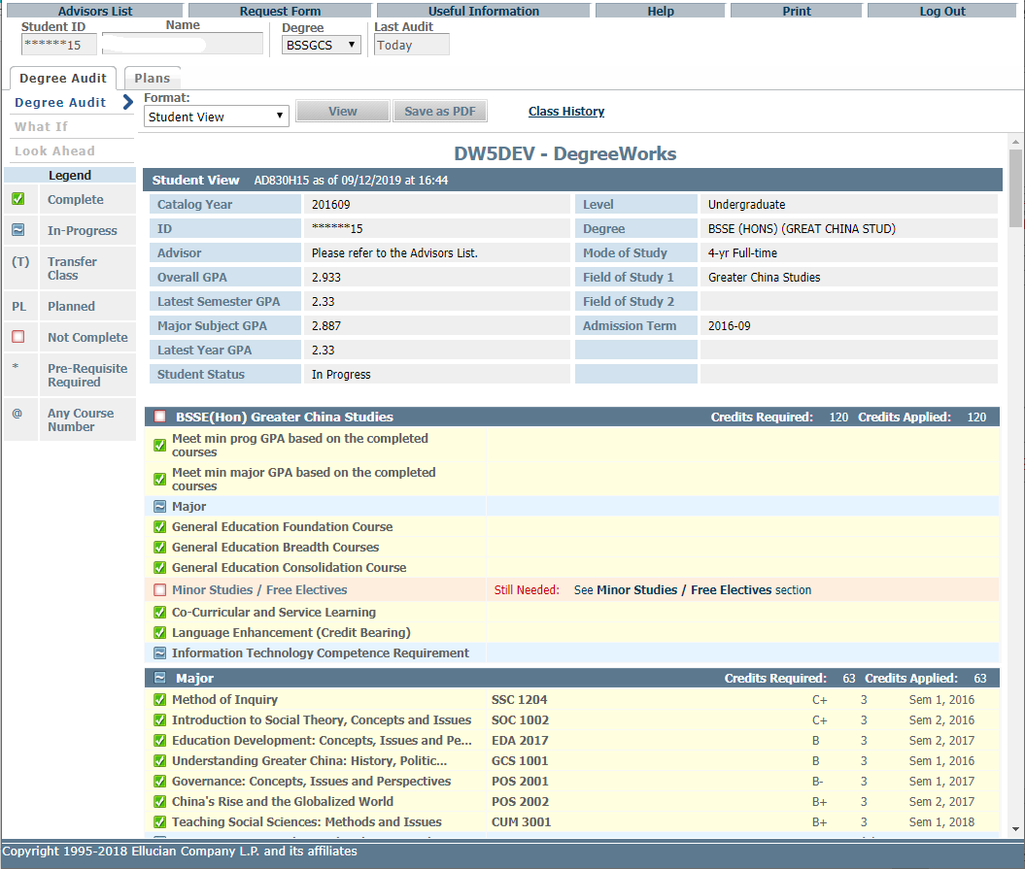
Function Button
List Format - Student View (Default)
- Registration Checklist
Student Information
Blocks
Interface

Slide 10
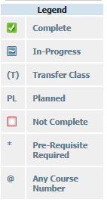
Program Requirement
Block/Domain fulfilment
Study Block
Interface

Slide 11
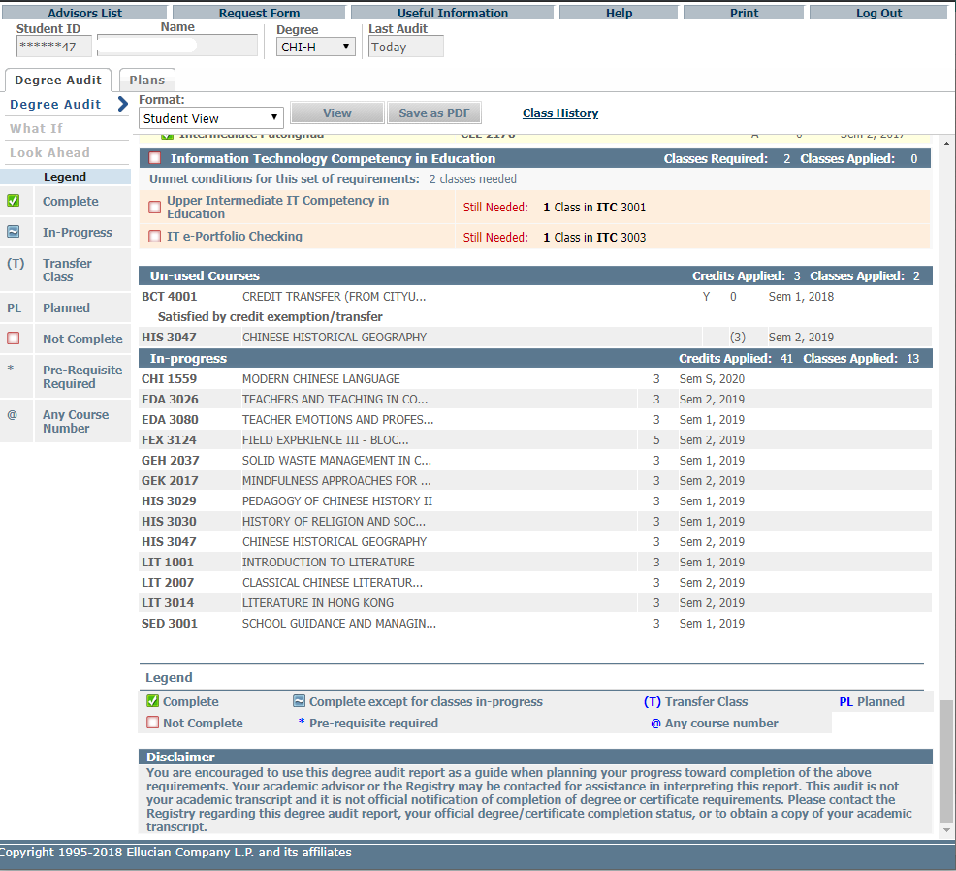
May still count towards your graduation requirements
Interface

Slide 12
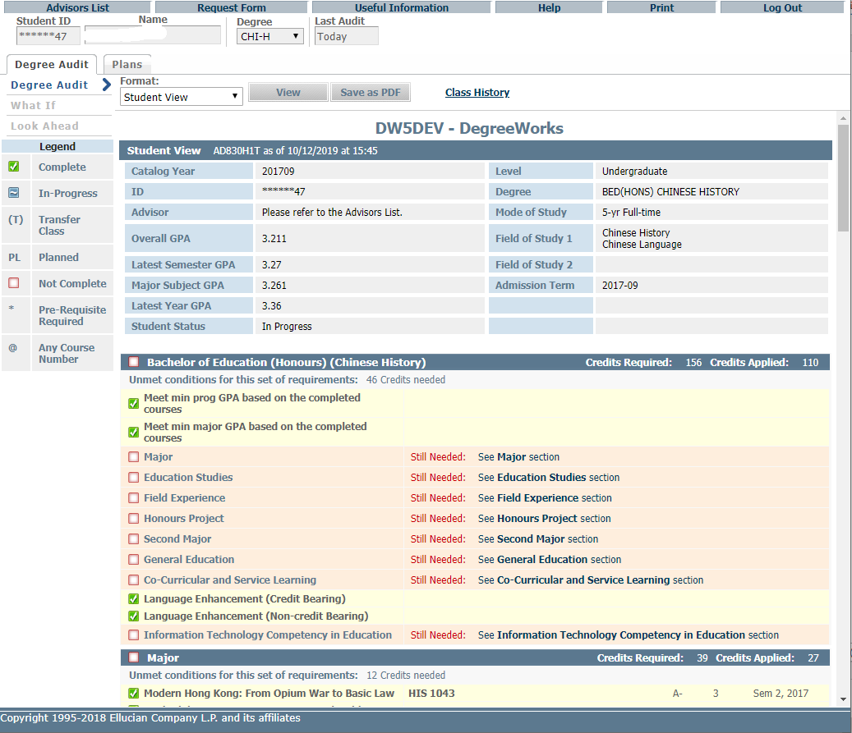
Save and download DAR for advising meeting
Degree Audit Report

Slide 13
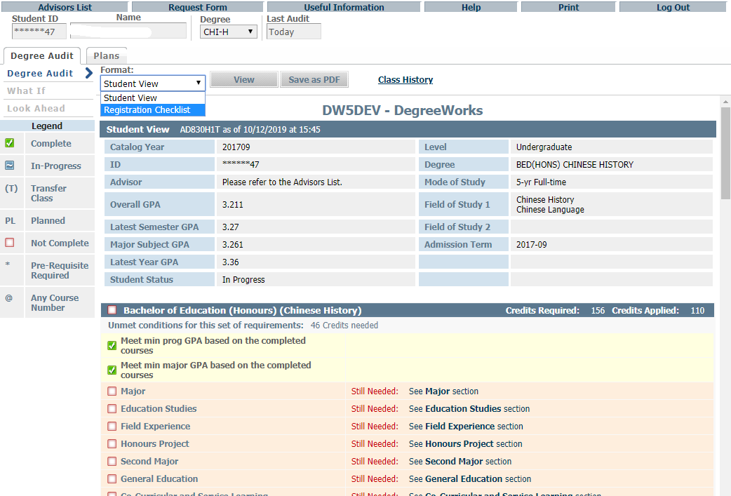
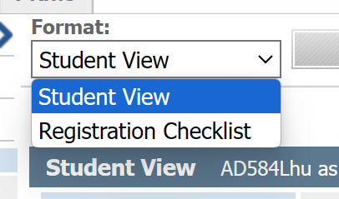
Choose from the drop down list and press “View” button
Degree Audit Report

Slide 14
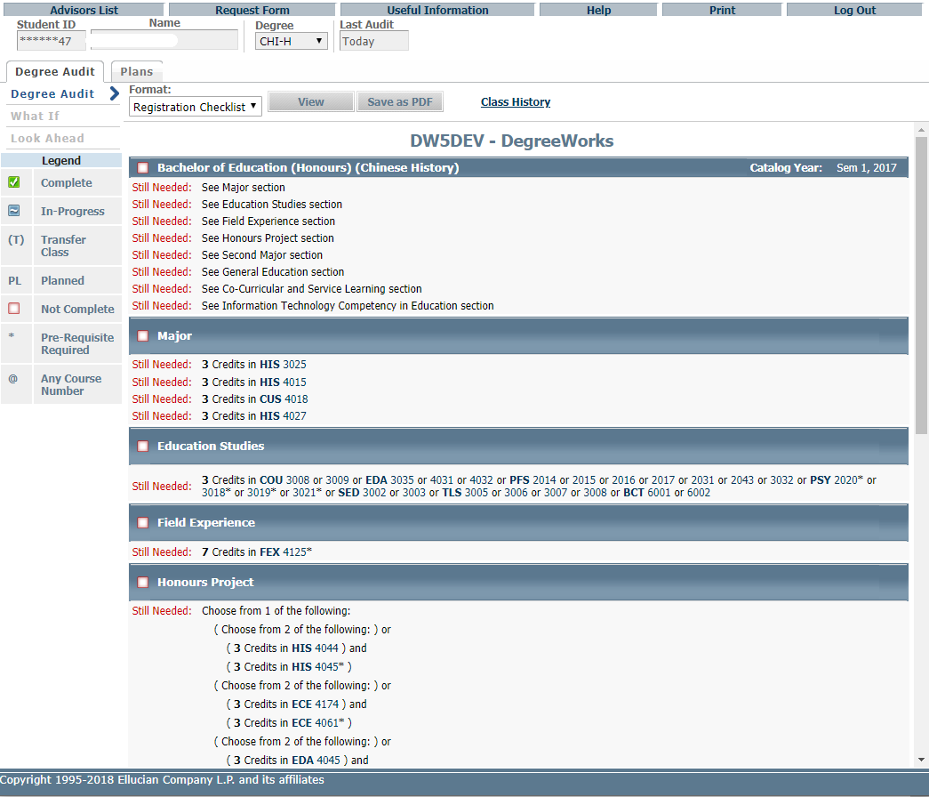
Courses still needed

Slide 15
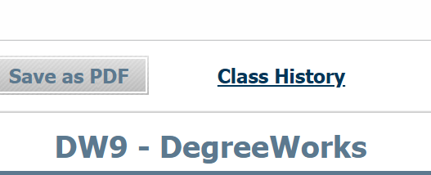
Class History
List of completed courses with grades and credits grouped by semester
Degree Audit Report

Slide 16
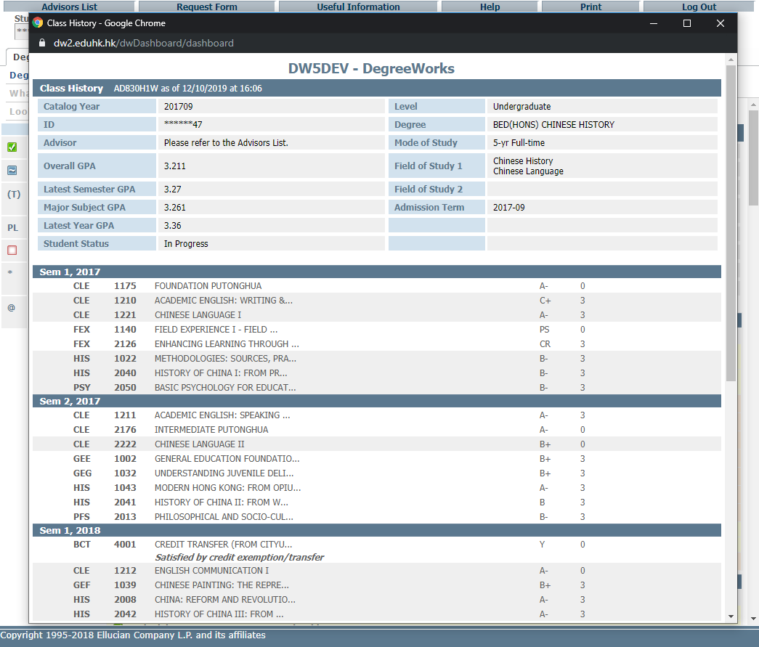
Listing of completed courses with grades and credits shown in chronological order

Slide 17
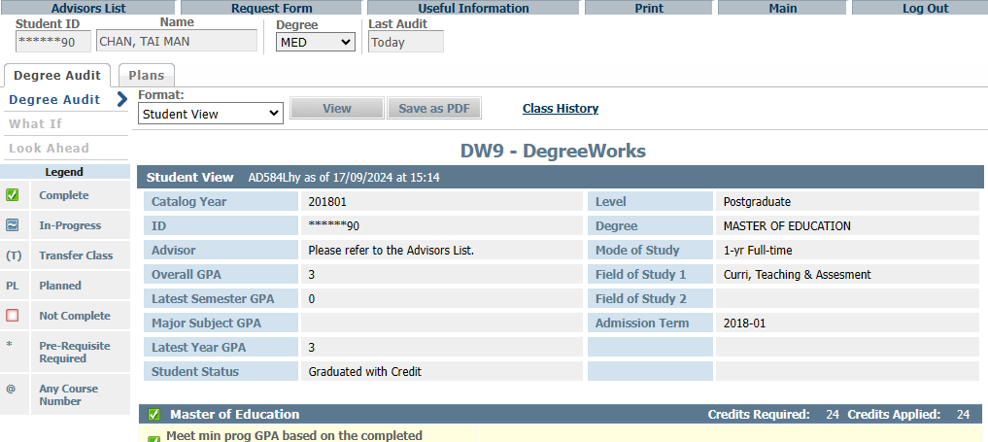
Complete the form and send email to Registry exam@eduhk.hk
Request for reviewing and updating audit report

Slide 18
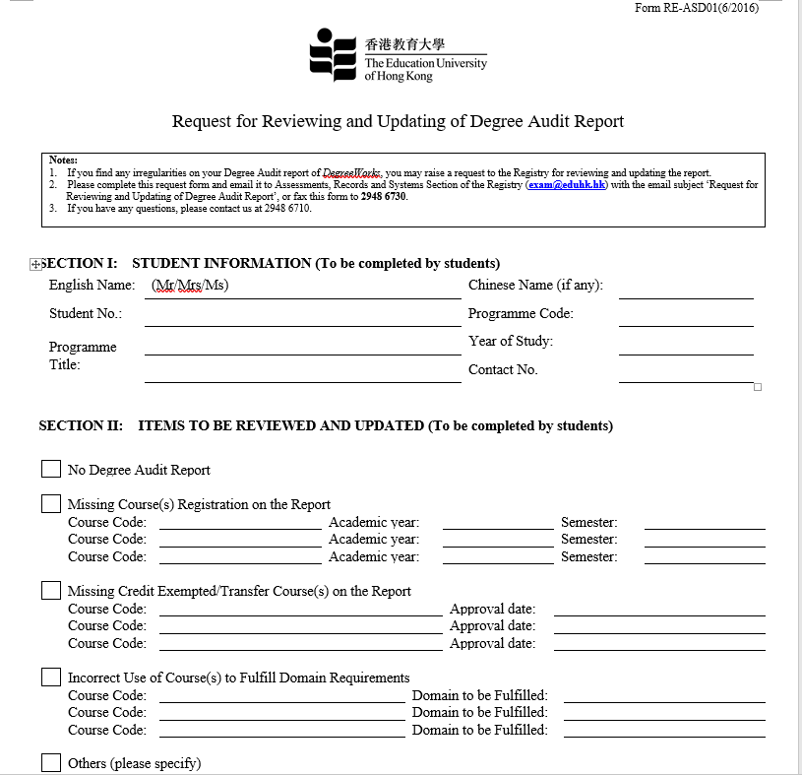
Complete the form and send email to Registry exam@eduhk.hk

Slide 19
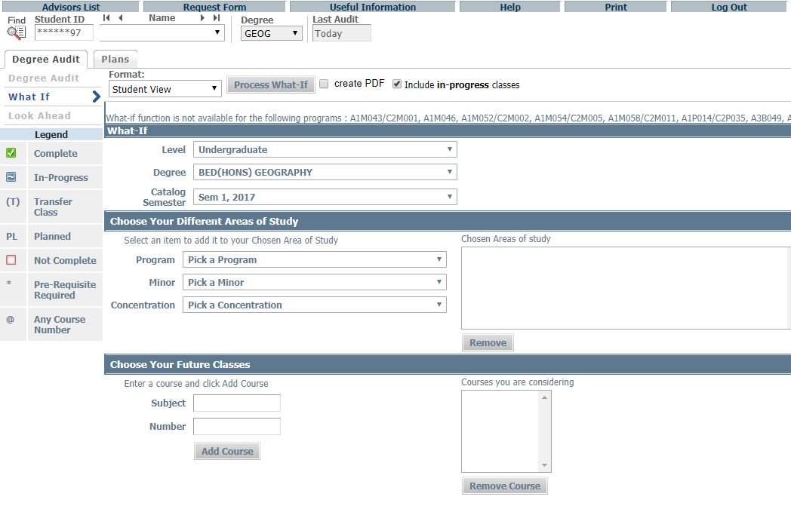
What IF
"What-if" function shows progress towards program completion
Plan for a Second Major, Minor, or Change of Program
Include unregistered classes for upcoming semesters

Slide 20
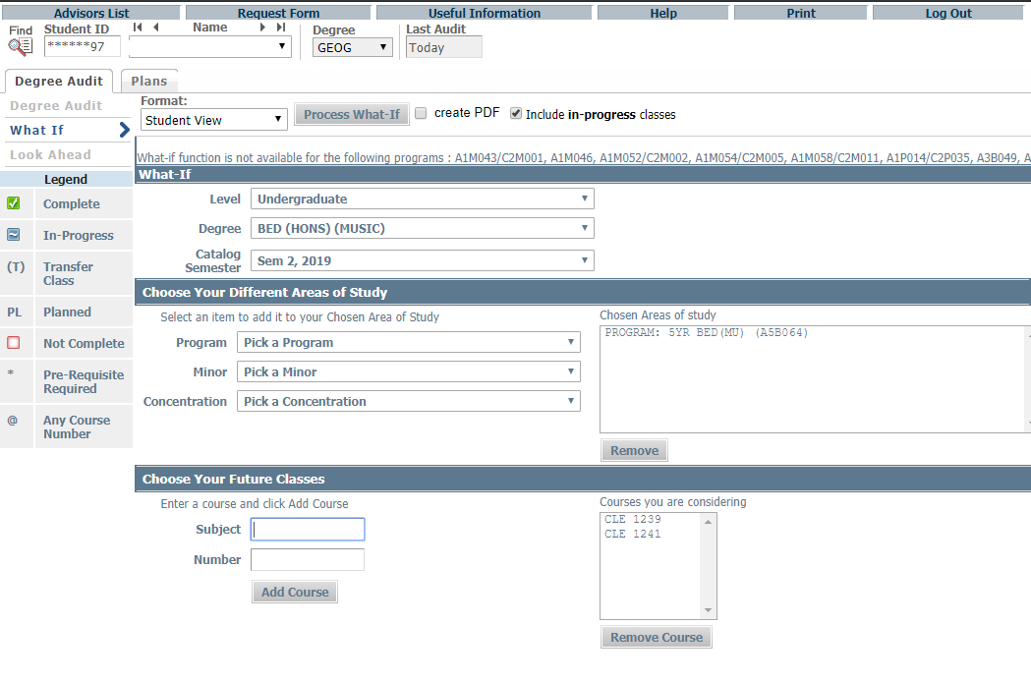
3.
Click here to process
1.
Choose program/ Concentration (Major) to check on the curriculum and course requirement
2.
Enter course code directly in here and press ‘Add’
Chosen Courses will shown in here

Slide 21
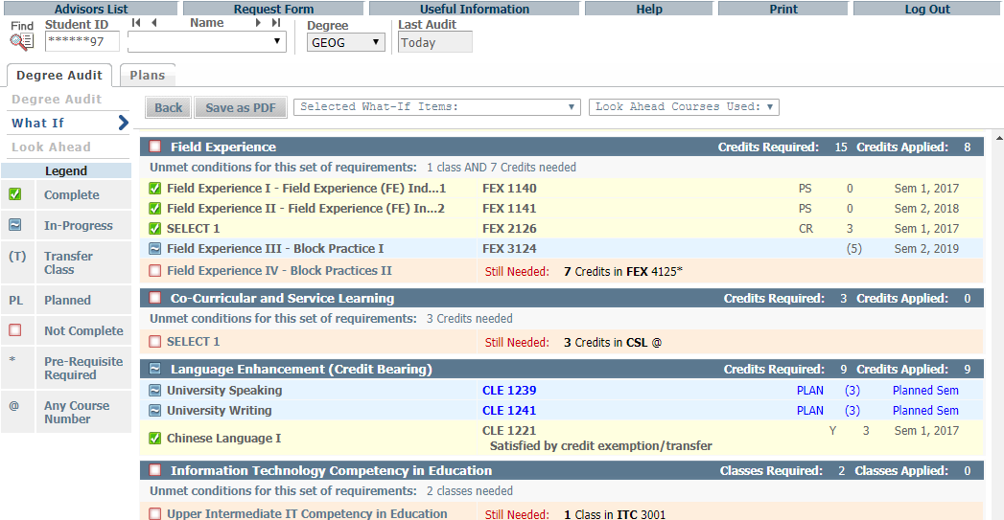
!!!!
Click “Save as PDF” before leaving the page, otherwise the plan will be lost
Planned courses will be shown in BLUE under the chosen semester
What IF
What-If audits are not stored in the database
The Results can be saved as PDF
Once you navigate away, the audit cannot be recalled

Slide 22
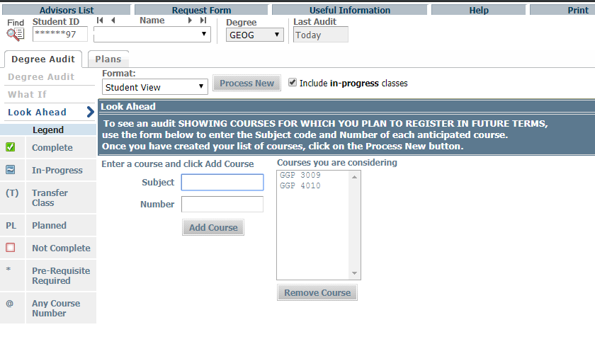
2.
Click here to process
Chosen Courses will shown in here
Enter course code directly in here and press ‘Add’
1.
You can remove chosen course here
Look Ahead
"Look Ahead" feature includes planned, unregistered courses in the audit

Slide 23
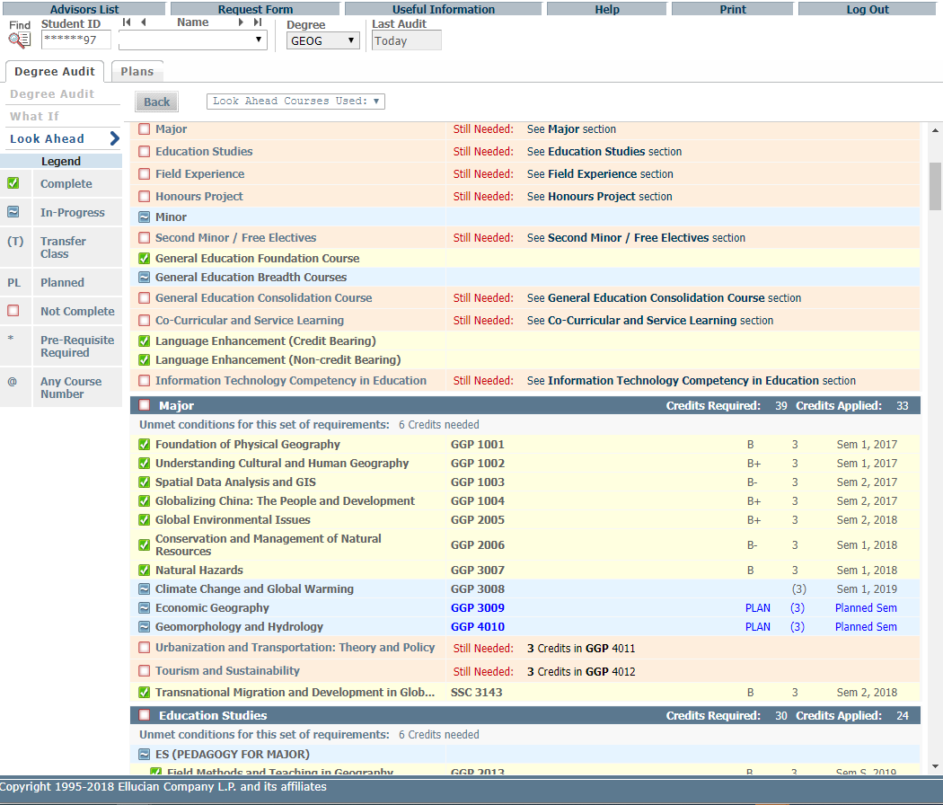
Planned courses will be shown in BLUE under the chosen semester

Slide 24
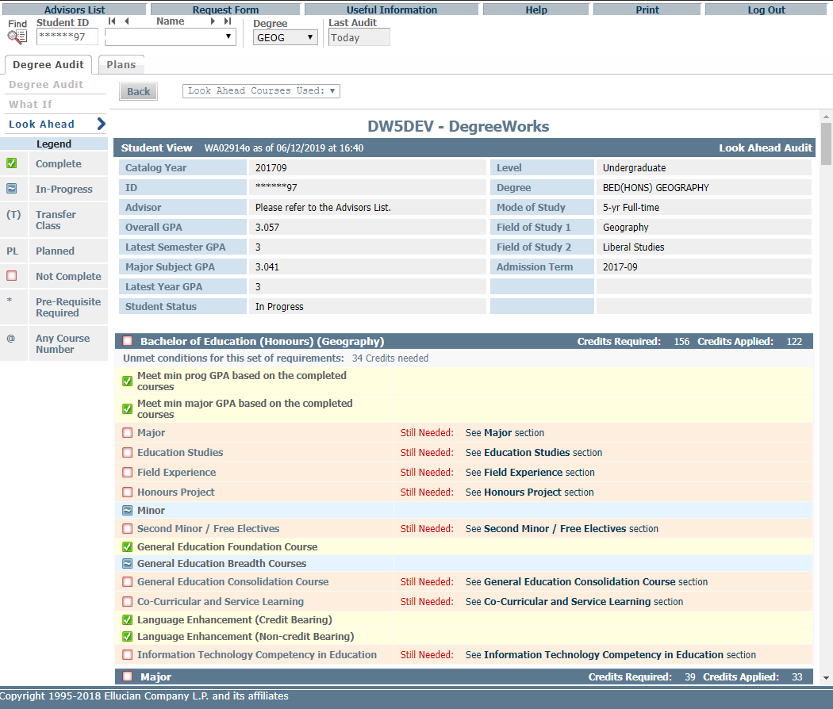
!!!!
Look Ahead
Look Ahead audits are not stored in the database
Results can only be saved by printing
Once you leave the page, the audit cannot be recalled

Slide 25
Student Educational Planner (SEP)
Why is having a study plan important?
Learning tool:
Helps students understand program requirements and how to meet graduation criteria
Self-evaluation tool:
Allows students to estimate course load and balance it with other commitments
Road map to success:
Provides clear direction for completing academic programs

Slide 26
Click ‘Plans’ to access the Student Educational Planner (SEP)
under Student View
Edit View
Click “View Plan List” if more than one plan is saved
Edit View is the default view to show all your saved study plans

Slide 27
The ‘Still Needed’ view provides course information from the student audit
The inventory list is expandable, and the drag-and-drop function for course selection can facilitate students to create plans.
The “Courses” view provides a Catalog inventory listing

Slide 28
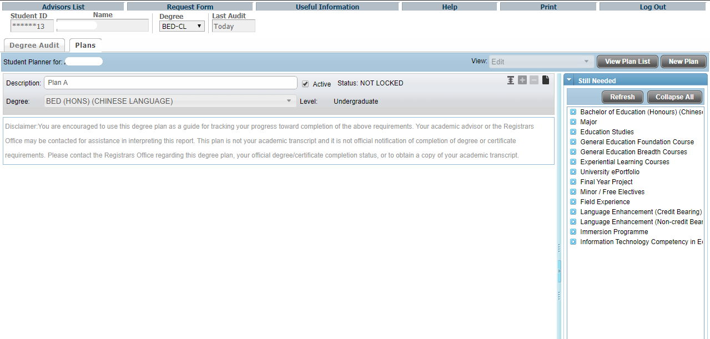
1.
To create a plan, you are required to type the name, e.g. Plan A, in the description.
3.
Click ‘New Plan’ to make a plan after viewing your saved one(s)
Each student can have numerous plans but ONLY ONE Active Plan, click here to make your plan ‘Active’. Old/outdated plans should not be marked active.
2.
Plan
Students can save their study plan as ‘Active’ to submit for advising meetings.

Slide 29
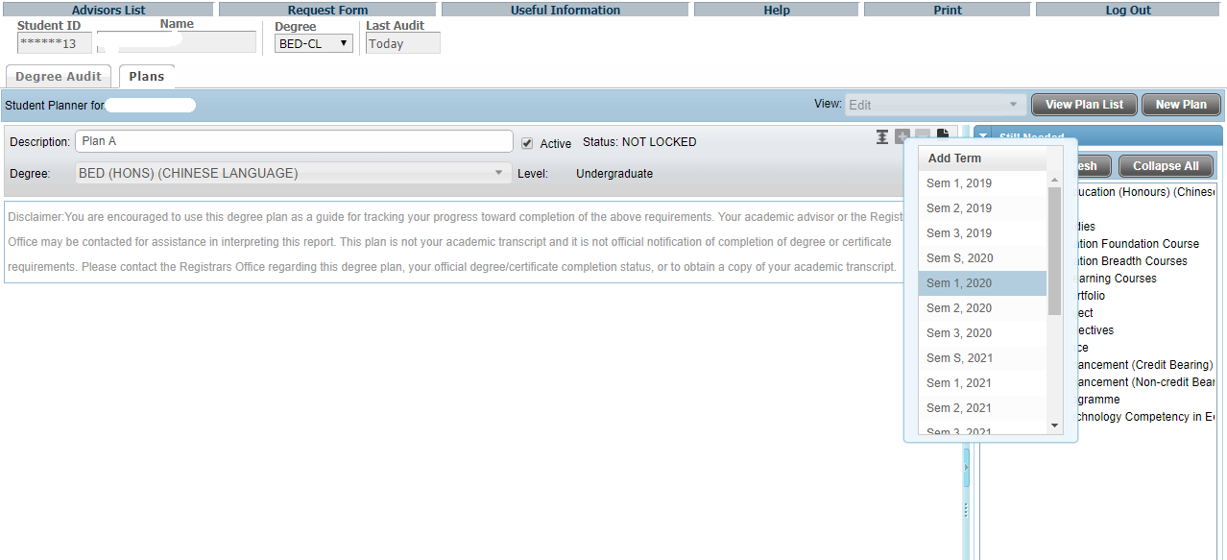
1.
Click here to add or delete the semester for your SEP
2.
Pick the semester for insert/delete
Plan

Slide 30
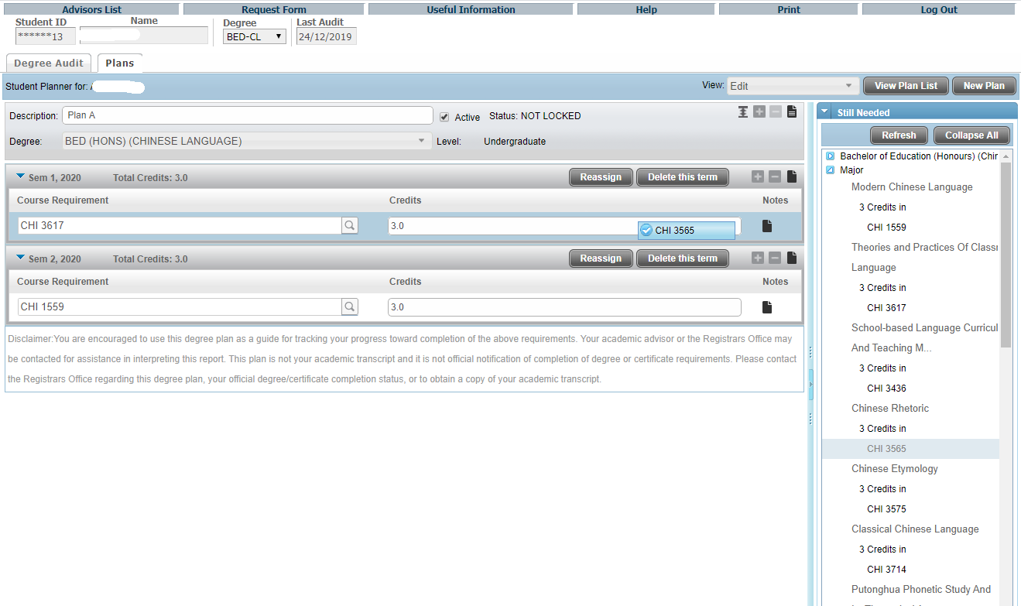
1.
You can enter the course code directly by clicking here
2.
Courses under ‘Still Needed’ or ‘Courses’ panel can be Drag-and-Drop into the designated semester
Plan

Slide 31
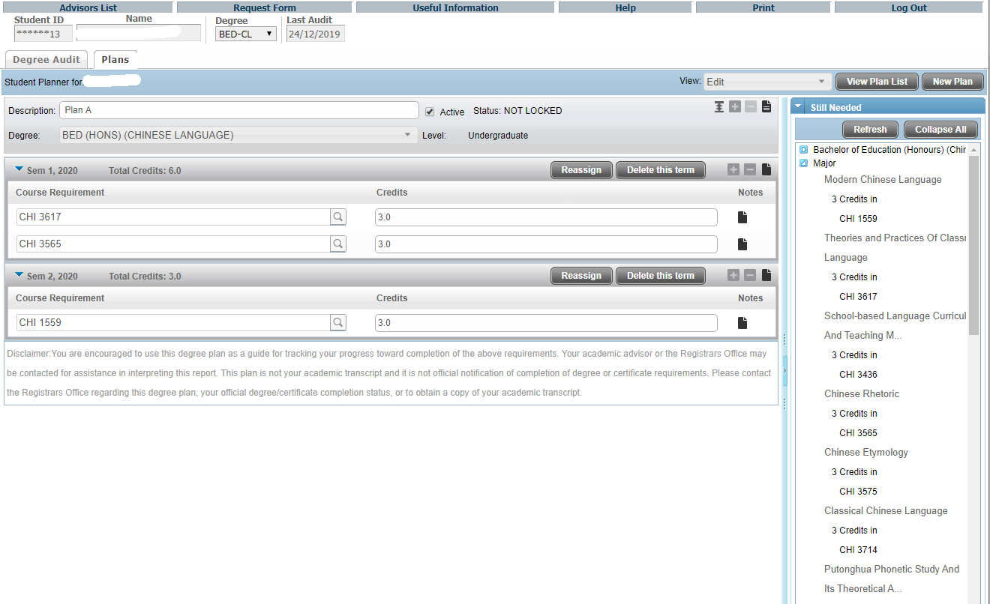
Once inserted, the selected courses will be shown in the designated semester.
You can reassign all selected courses to another semester;
or
Delete the whole semester.
Plan

Slide 32
Click “Reassign” button to edit
Plan

Slide 33
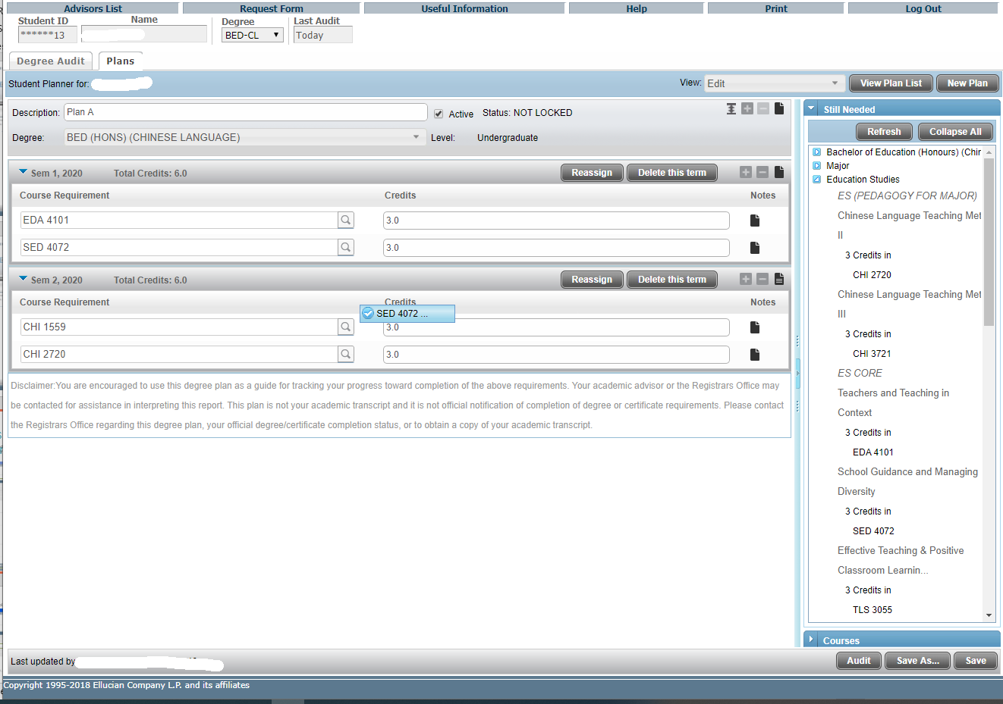
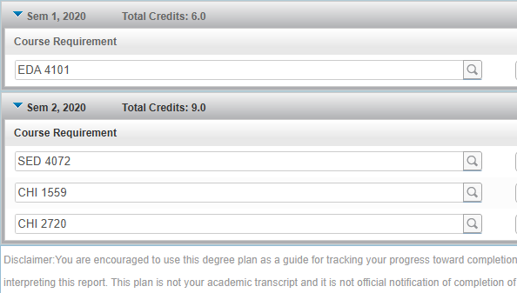
Drag the course from Sem 1, 2020 to Sem 2, 2020
Press ‘Save’ for an existing plan or ‘Save As’ for a different plan

Slide 34
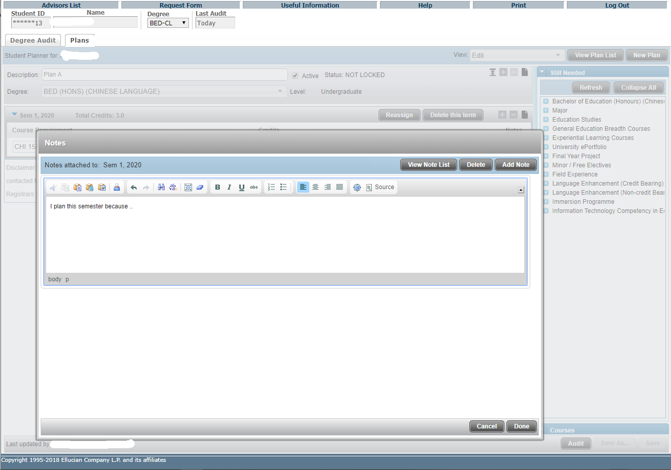
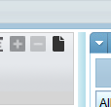
1.
2.
Click here to enter the Plan-level note
(in ENGLISH only)
or leave messages to your advisor when reviewing your plan.
3.
Click ‘Done’ to save
Plan

Slide 35
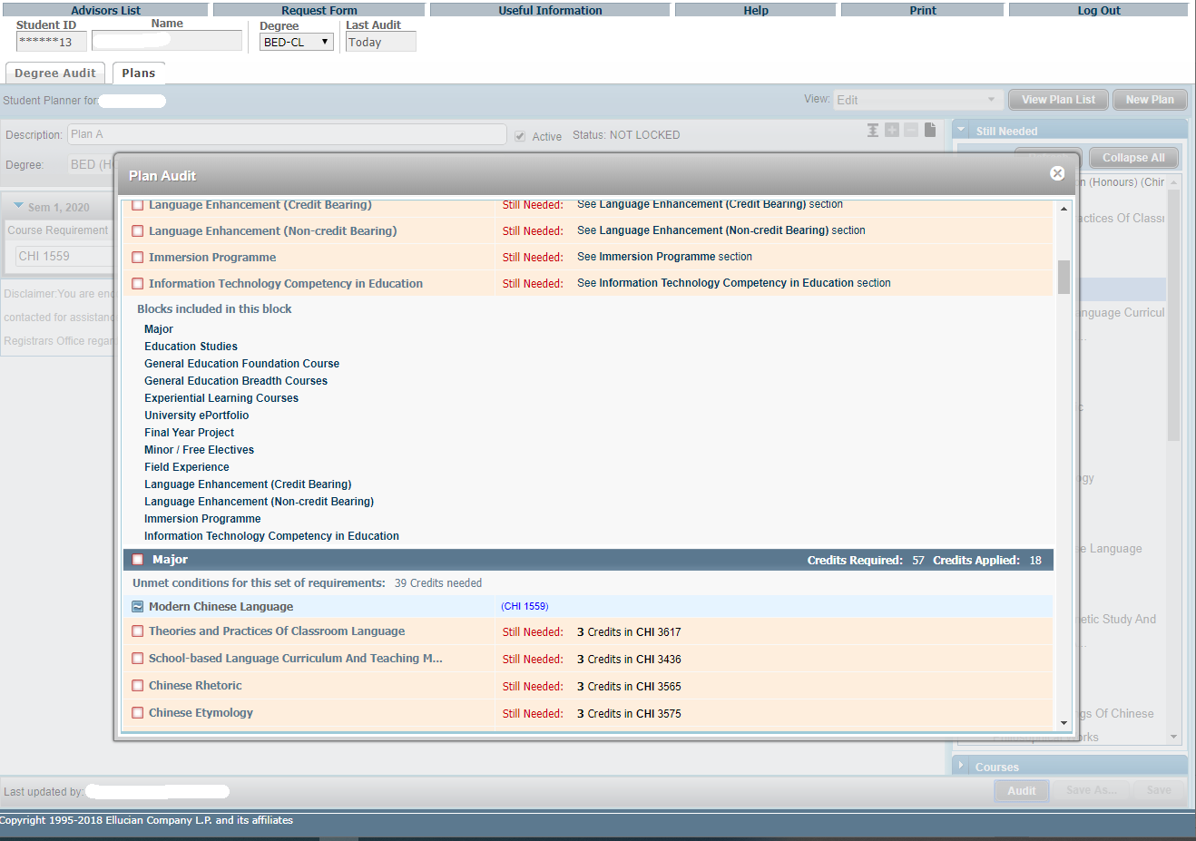
2.
The planned requirements are highlighted
Click ‘Audit’ in Edit View to generate a Plan Audit, which will display all courses from the Plan in an advising worksheet in an embedded window.
1.
Plan

Slide 36
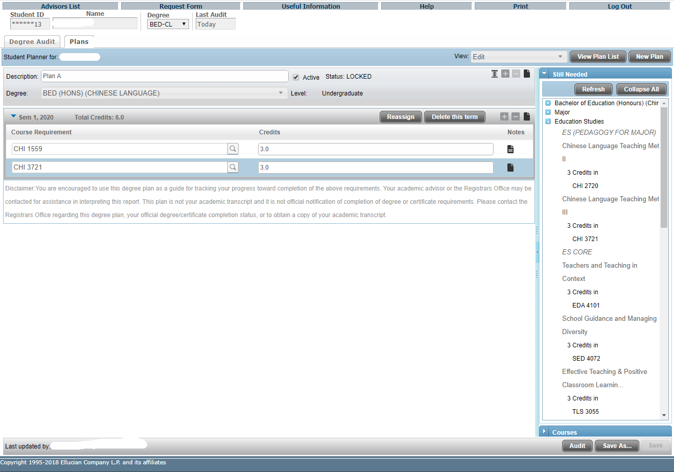
There is a ‘LOCKED’ key for advisors to prevent their advisees from making any changes to a plan that had been reviewed/discussed.
Students cannot make any modification to the ‘LOCKED’ plan but can recall and ‘Save As’ another plan for editing.
Plan

Slide 37
View All Plans
2.
Click “Delete” and “Yes” to confirm to permanently delete the plan.
1.
To delete an un-used plan, click to select the plan.
View Plan List
Click “View Plan List” to view the full list of your plan(s) including ‘Active’.

Slide 38
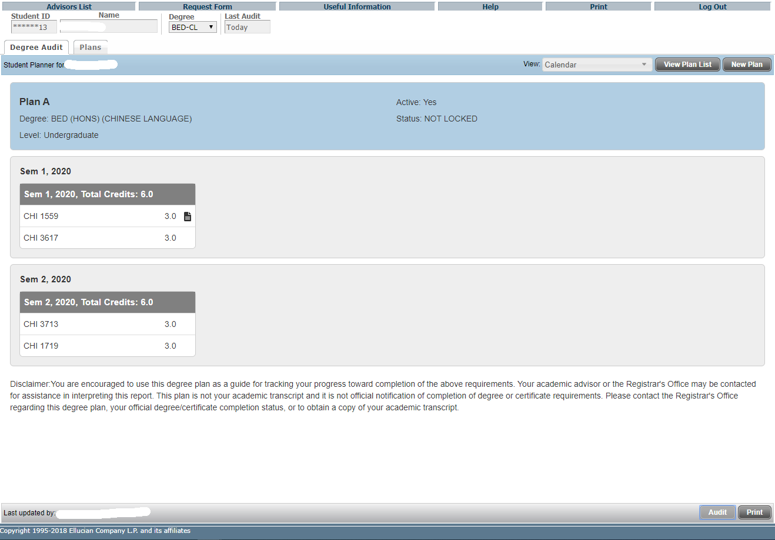
List View - Calendar
- Notes
Display study plan in calendar presentation that is suitable for printing.
(No editing is available in this view )
Calendar View

Slide 39
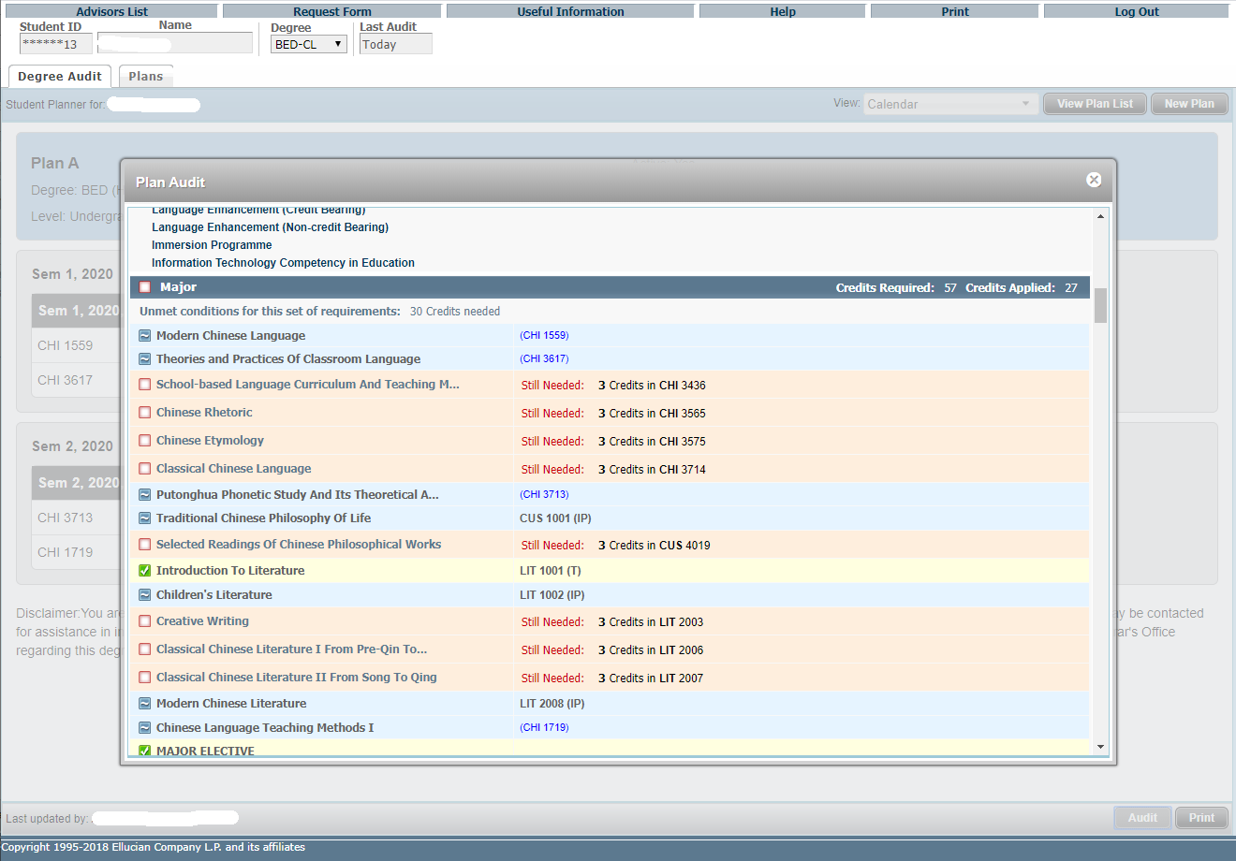
2.
Click ‘Audit’ in Calendar View to generate a Plan Audit, which will display all courses from the Plan in an advising worksheet in an embedded window.
The planned requirements are highlighted
1.

Slide 40
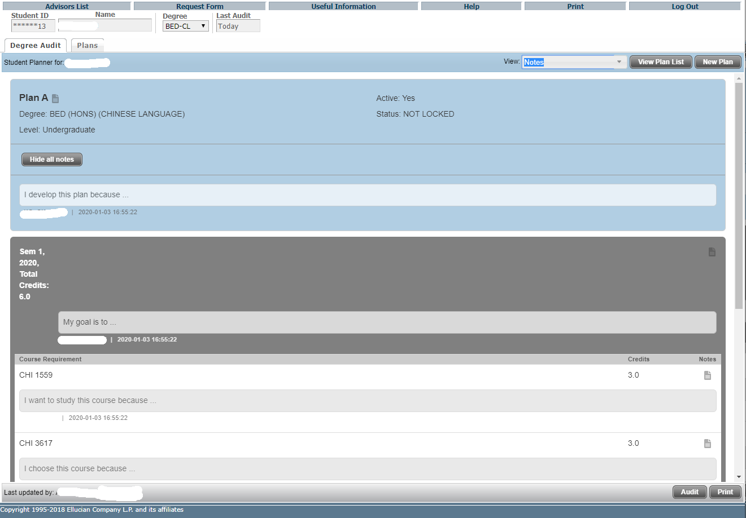
1.
The Notes view allows the user to view a plan in a comprehensive presentation that is suitable for printing.
(Again, no editing of the plan is available in this view )
Under the Expanded mode, all selected courses, semesters and notes display underneath the corresponding items and will be included when printing. Click “Print” for printing.
2.
Notes

Slide 41
Calendar View
Notes

Slide 42
Click “Hide all notes” to enter Collapsed mode
Notes

Slide 43
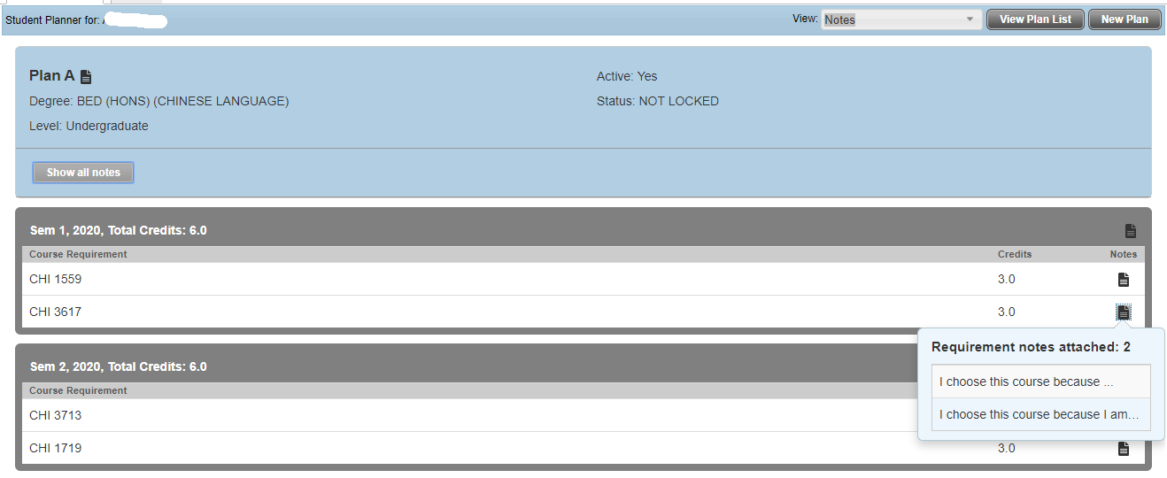
With the Collapsed mode, only a note icon will display with NO content will be included when printing.
Hover to show a note preview, and click on this icon to open the Notes window.
Notes

Slide 44
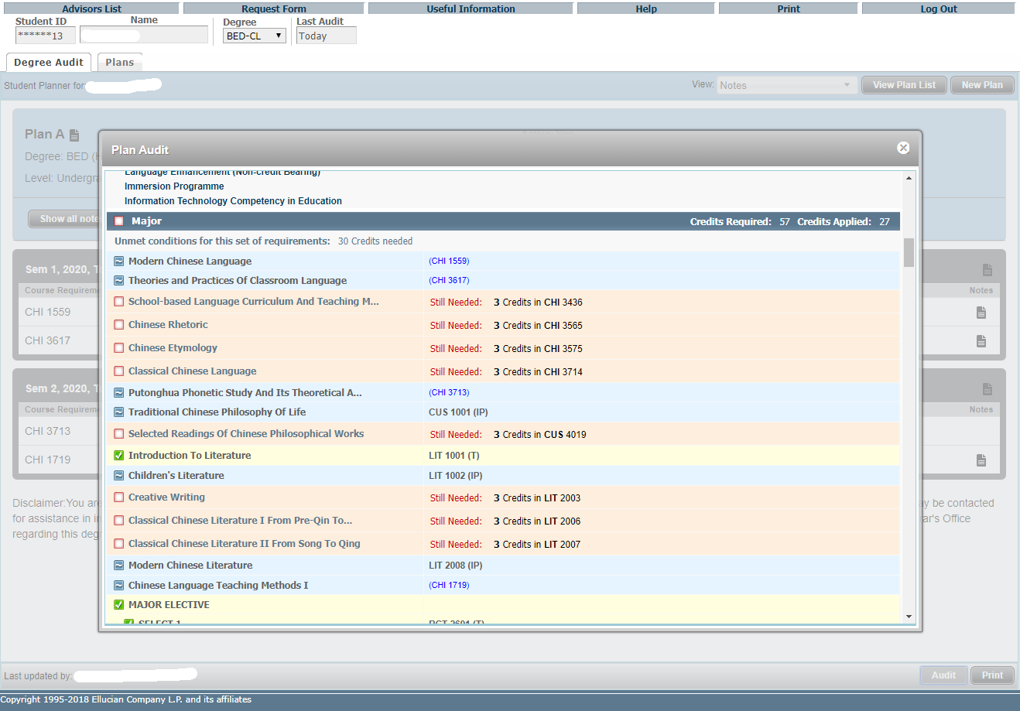
2.
The planned requirements are highlighted
Click ‘Audit’ in Notes View to generate a Plan Audit, which will display all courses from the Plan in an advising worksheet in an embedded window.
1.

